Slide 1
Jazz age

Slide 2
$$ expansion
Post-war
Causes?

Slide 3
Capital investment
Mass production, machines
Electricity
“Auto” Age

Slide 4
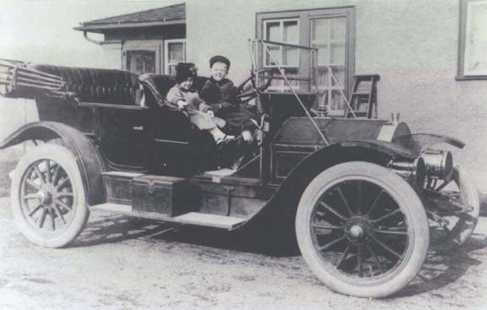
Culture
1920’s: 85% cars
1 in 14
New markets
Leisure, travel
Social norms

Slide 5
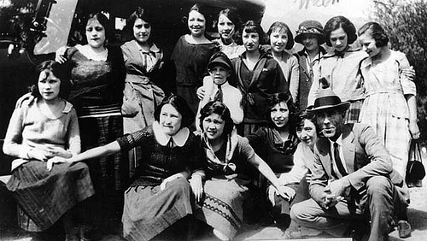
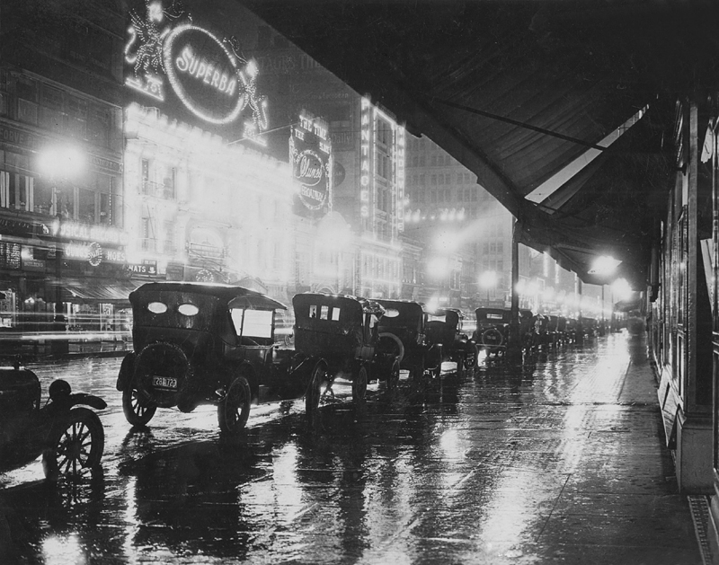
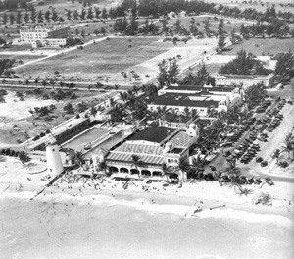
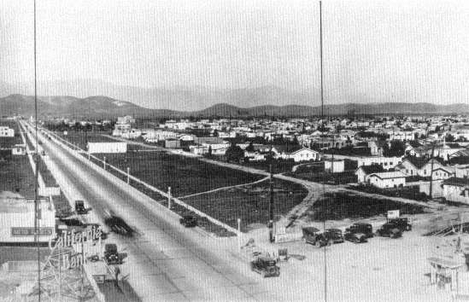
Cities
L.A. – 5th largest
Suburbs
Excluded minorities, working class
Latinos
Barrios
N.Y., L.A.

Slide 6
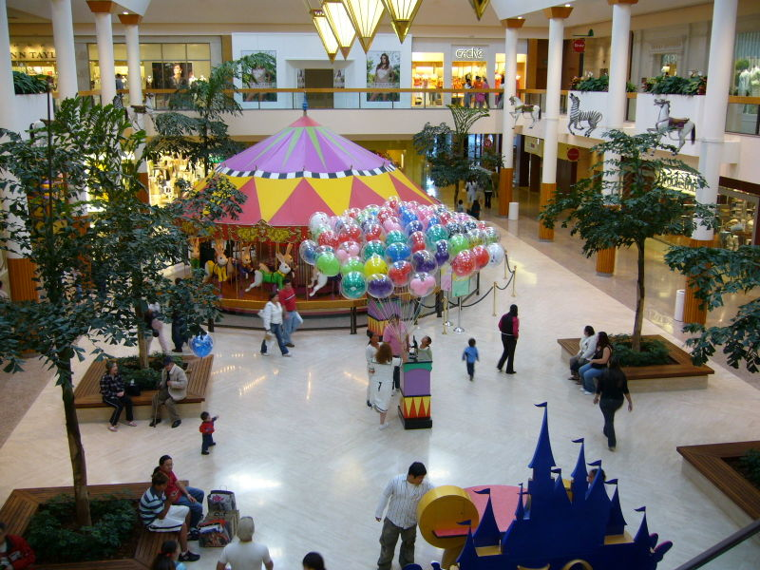

Slide 7
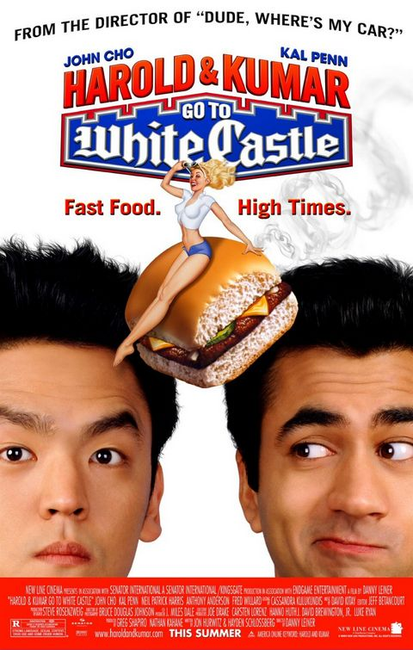
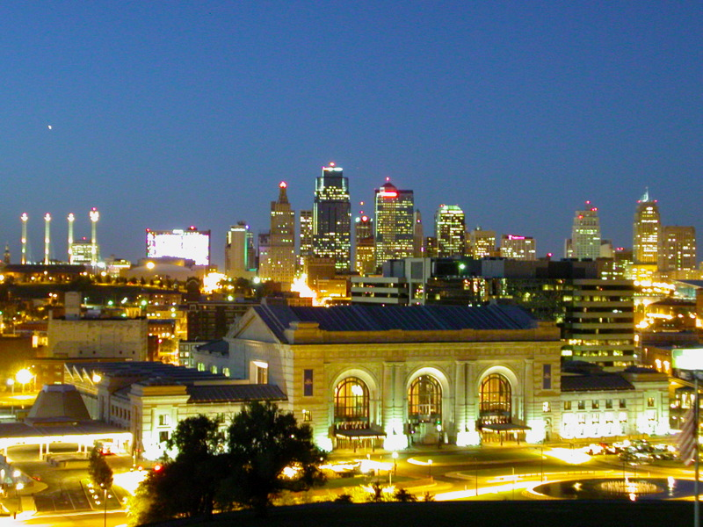
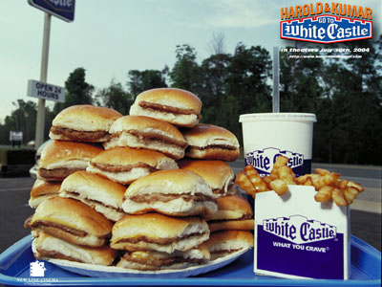
Country Club Plaza, 1922
K.C.
Shopping center
White Castle, 1921
First fast food chain

Slide 8
Welfare capitalism
Benefits
5% of workers
71%
Below “decent standards”

Slide 9
KKK
Revival
National, middle-class, white-collar
Catholics, Jews, others
3 million members
Today?

Slide 10
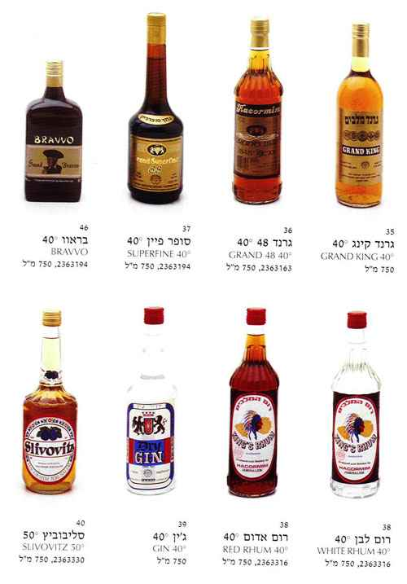

Slide 11
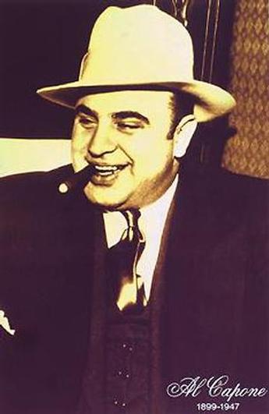
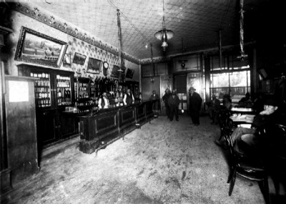
PROHIBITION
Enforcement?
“moonshine”, smuggled
“Speakeasy”
Organized crime
Al Capone
Bootlegging: $$$ profits

Slide 12
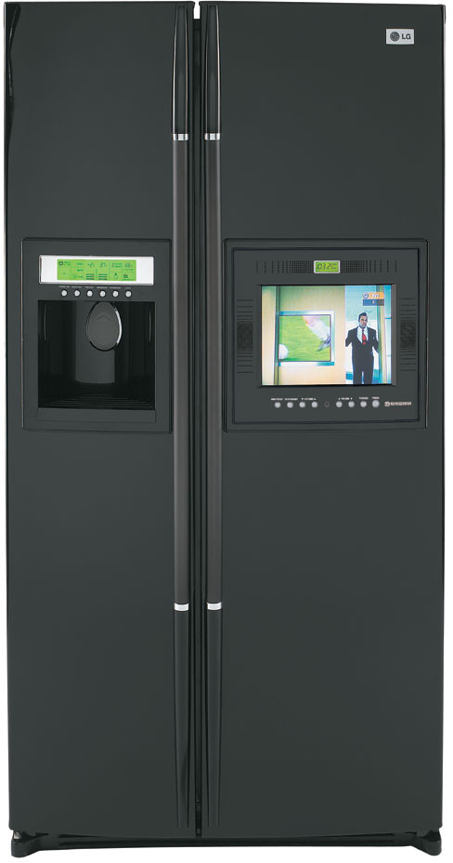
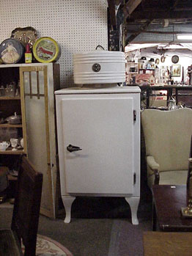

Slide 13
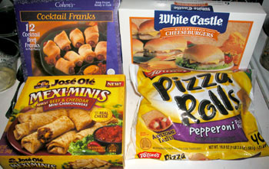
+ Living standards
Electricity
Appliances

Slide 14
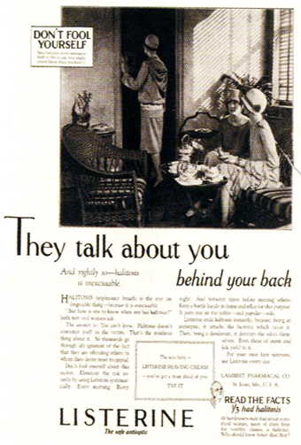
MASS MEDIA
Advertising
Listerine

Slide 15
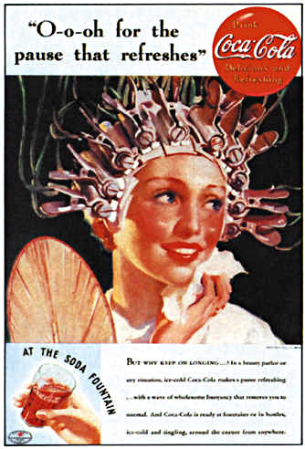

Slide 16
Radio
NBC, CBS
Shows, music

Slide 17
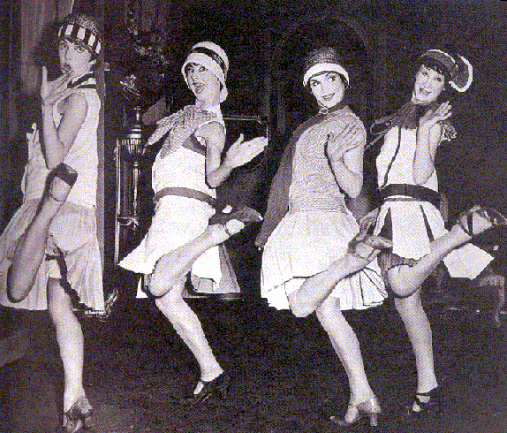
Flapper
Movies, novels
Young, short skirts

Slide 18
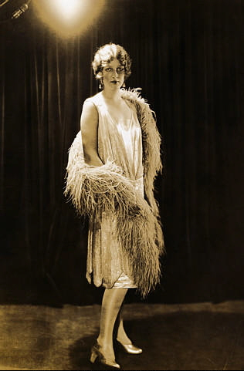
Before WW1
1920’s

Slide 19
NATIONAL CULTURE
Emerging

Slide 20
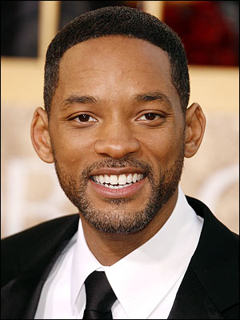

Slide 21
NATIONAL CULTURE
Emerging
Same experiences

Slide 23
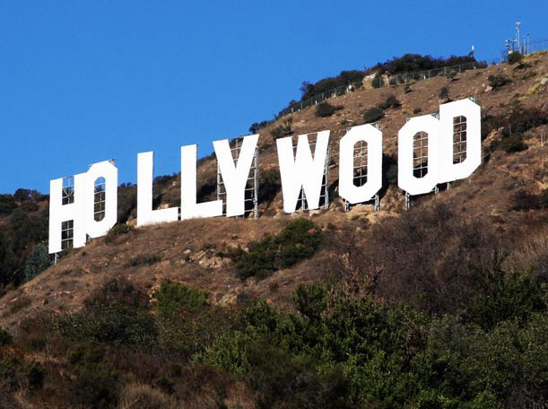
HOLLYWOOD
N.Y. to Hollywood
Russian Jewish immigrants
Consolidated
MGM, Universal
Movie stars
L.A. ideal

Slide 24
HARLEM RENAISSANCE
Harlem
Cultural capital
Black arts movement

Slide 25
Harlem
Intellectuals

Slide 26
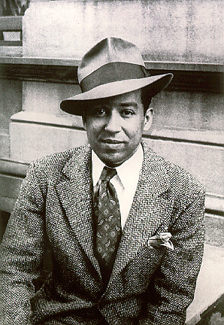
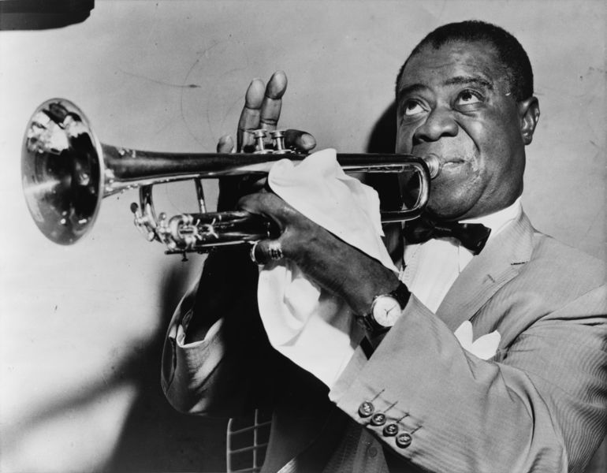
Poets: Langston Hughes, Claude McKay
Writers
“Jazz Age”
Louis Armstrong

Slide 27
CLAUDE MCKAY

Slide 28
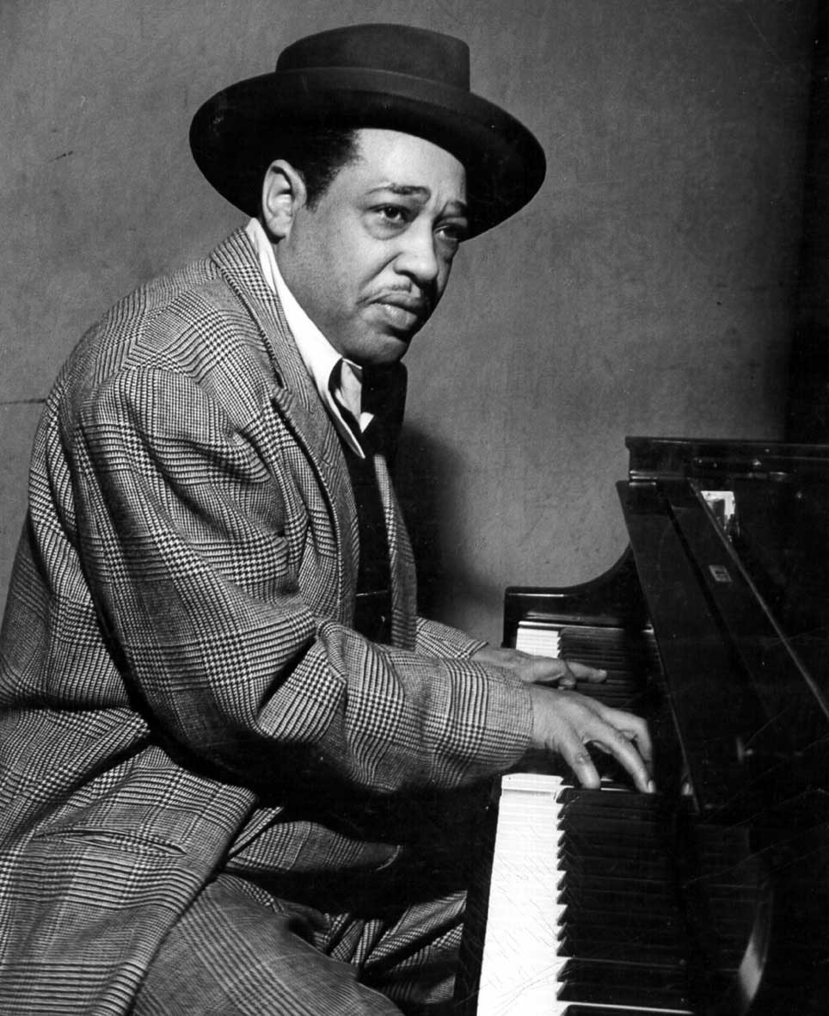
LOUIS ARMSTRONG

Slide 29
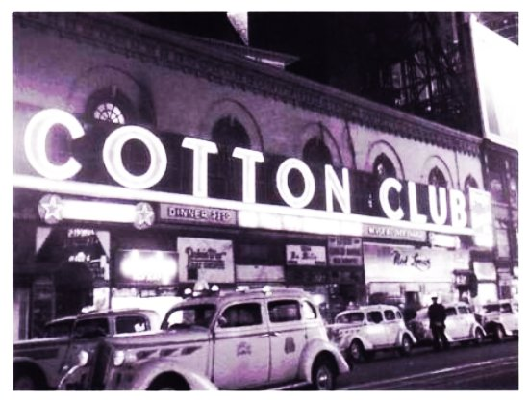
Poets: Langston Hughes, Claude McKay
Writers
“Jazz Age”
Duke Ellington
Young Whites
Alcohol, music
Organized crime
Segregated

Slide 30
Segregation, violence, and racism

Slide 31
Attitudes towards sex
Sex, advertising

Slide 32
Attitudes towards sex
Sex, advertising

Slide 33
YOUNG
Rebellion
Music, style

Slide 35
dating
1890-1925: common
“calling”
Pre-1880’s
Lower class, urban-industrial
Private to public
Power: women to men
Men’s world, money
Economics?

Slide 36
SLANG
Beef: complaint, to complain
Gold digger: woman who pursues men for $$
Jack: money
Knock up: sexual innuendo
Pipe down: stop talking
Level with me: be honest
Tight: attractive

Slide 37
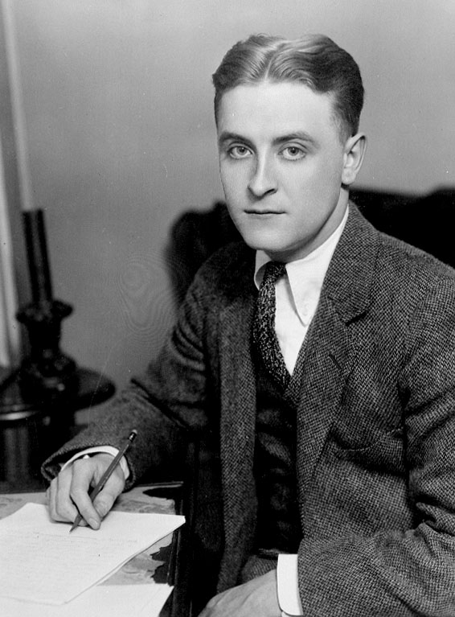
LOST GENERATION
Famous writers
Anti-materialism
Hemingway, Fitzgerald

Slide 38
POLITICS
Isolationism
Stock market crash

