Slide 1
COLD WAR

Slide 2
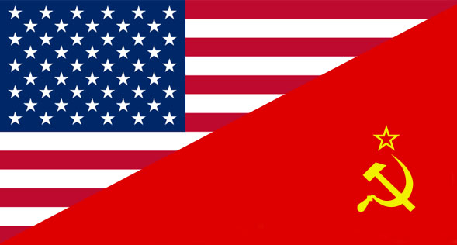
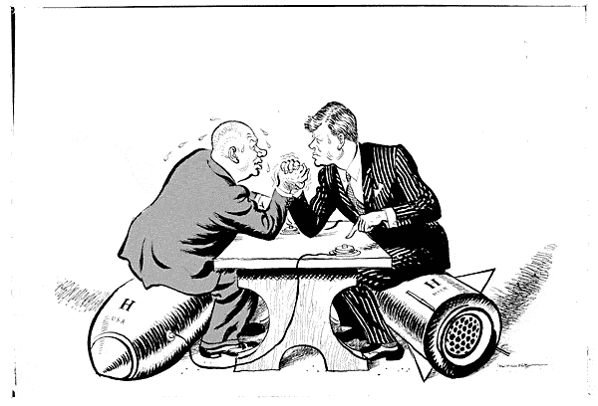
ORIGINS
U.S.
Soviet
Competing values?

Slide 3
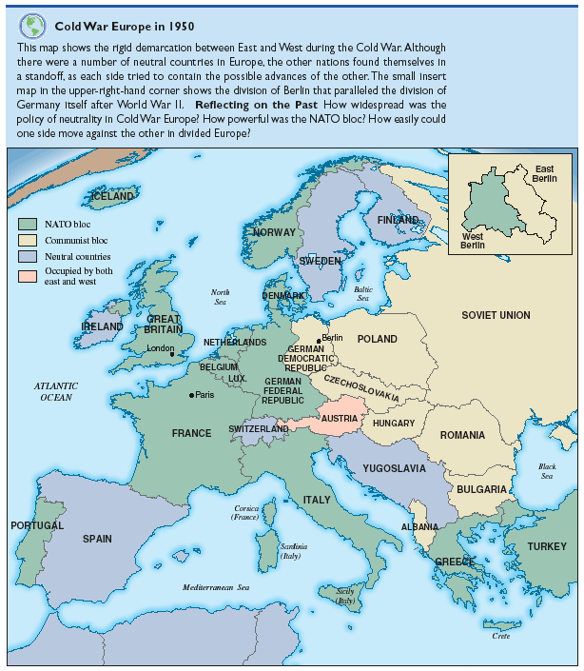

Slide 4
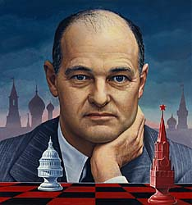
Containment
George Kennan
Communism

Slide 5
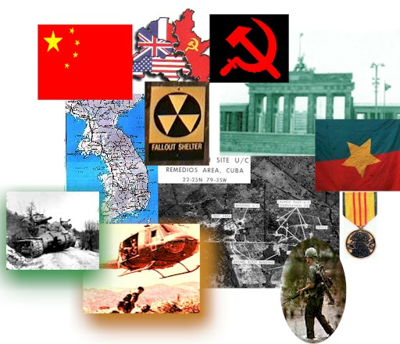
Truman Doctrine
Containment
“support free peoples” --Harry Truman

Slide 6
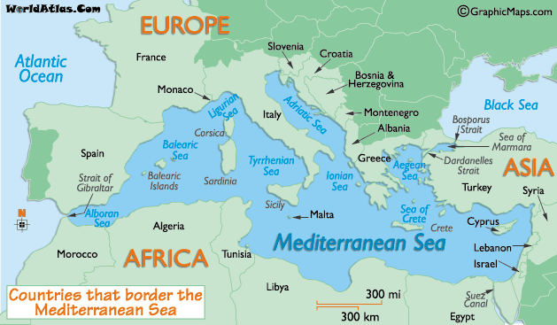
Money countries
Greece, Turkey

Slide 7
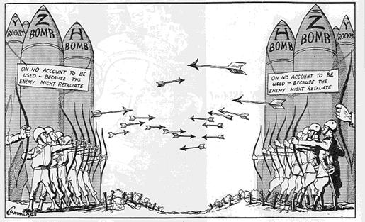
NATIONAL SECURITY ACT (1947)
D.O.D.
NSC
CIA

Slide 8
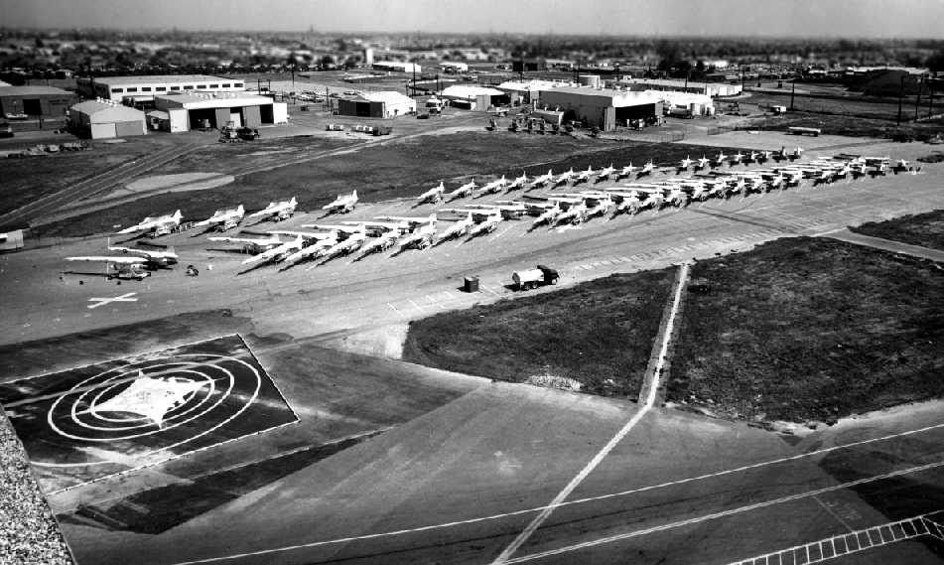
MILITARY-INDUSTRIAL
California
Military bases
L.A.
50’s, 60’s: workers
Defense, aerospace
O.C., S.F.
???

Slide 9
CULTURE
Family
Spending

Slide 10
ASIA
China

Slide 11
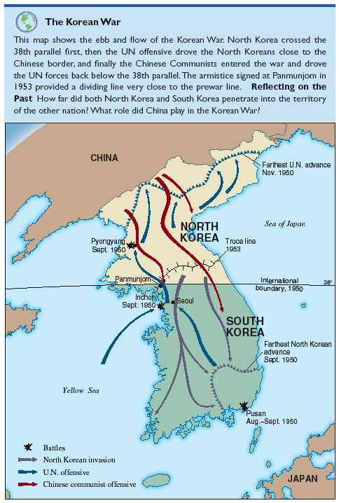

Slide 12
MIDDLE EAST
Israel vs. Arabs

Slide 13
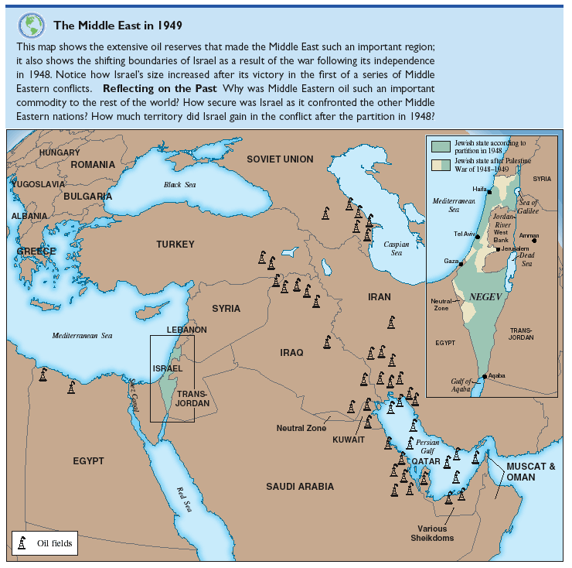

Slide 14
