Slide 1
CHAPTER 11
EVERYDAY LIFE: 1840-1860

Slide 2
INDUSTRY
Prosperity
Upper class
Technology
Transportation

Slide 3
IMPROVEMENT
some improvement
Flushing toilet, running water
Most struggled

Slide 4
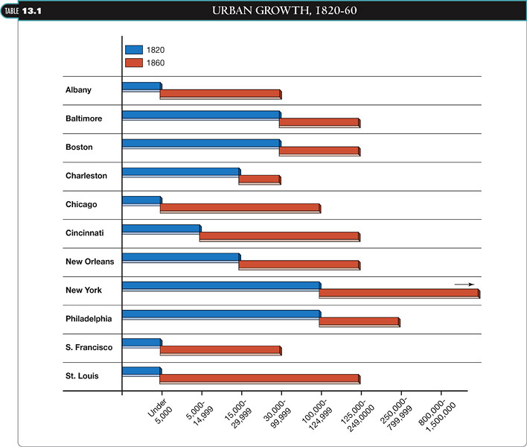

Slide 5
URBANIZATION
Cities
N.Y., Chicago
Transportation hubs

Slide 6
URBAN PROBLEMS
Housing segregation
Poor, middle class, rich
No municipal services
Water, sewer, garbage
Epidemic diseases
Changed by 1860

Slide 7
MIGRATIONS
Into America
Throughout America
Trail of Tears, Internal slave trade
Ireland, Germany, Scandinavia

Slide 8
IRISH
Causes?
1850’s: 1.7 million
“No Irish Need Apply”
Illiterate Catholics peasants
Irish women
Oppression and hardships endured

Slide 9
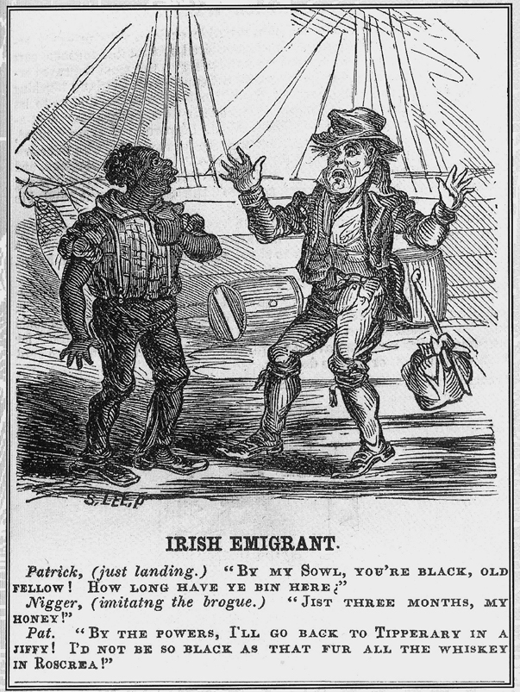
This cartoon encounter between a newly arrived Irishman and an African American expresses the fear of many immigrants that they would be treated like blacks and denied the privileges of whiteness.
SOURCE:Diogenes,Hys Lantern ,August 21,1852,reprinted from Noel Ignatiev,How the Irish Became White (1995).

Slide 10
GERMANS
Similar to Irish
Skilled, intellectuals
Farming clusters=communities
Today:
Largest ethnic agricultural owners

Slide 11
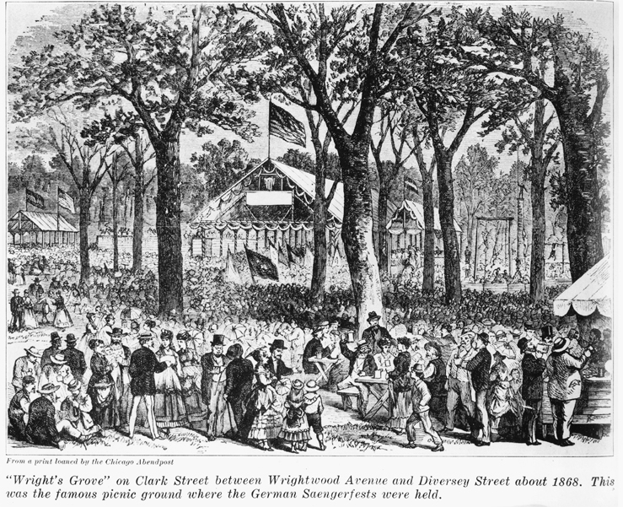
Wright’s Grove, shown here in an 1868 illustration, was the popular picnic grounds and beer garden for the large German community on Chicago’s North Side. Establishments such as this horrified American temperance advocates, who warned about the dangerous foreign notion of mixing alcohol with family fun. SOURCE:Chicago Historical Society.

Slide 12
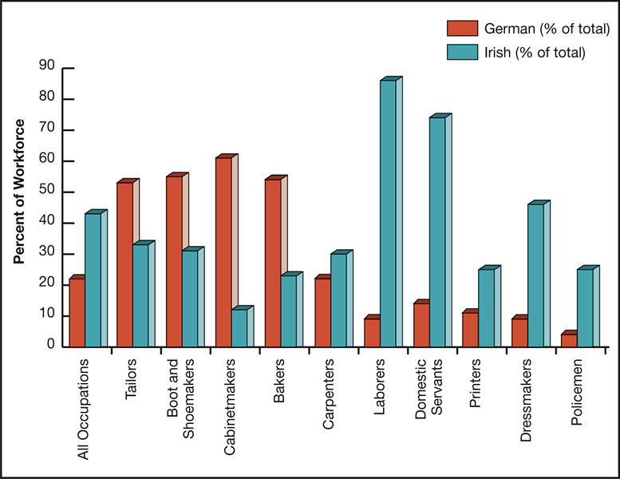
FIGURE 13.1 Participation of Irish and German Immigrants in NY City Workforce for selected occupations 1855 SOURCE:Robert Ernst,Immigrant Life in New York City 1825 –1863 (Syracuse:Syracuse University Press,1994).

Slide 13
ETHNIC COMMUNITIES
Today?
Surroundings, language, customs
Integrating “old” country

Slide 14
ETHNIC COMMUNITIES
Churches, schools
Concert halls, theaters
Newspapers
Restaurants, shops

Slide 15
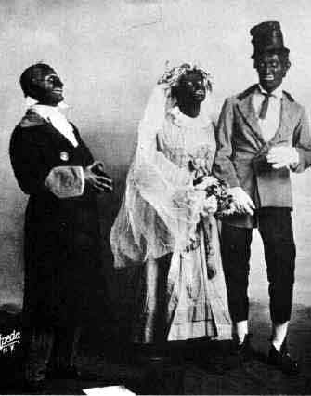
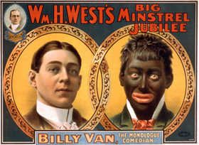
ETHNIC URBAN CULTURE
Minstrel shows
Popular entertainment
White House, presidents

Slide 16
American renaissance
Literature
Before 1800: classicism
Educated
Showed knowledge
Hawthorne, Melville

Slide 17
ROMANTICISM
Popular lit.
Common people
Emotional
True feelings
Regional, local feel
James F. Cooper
Last of the Mohicans
Fictional characters

Slide 18
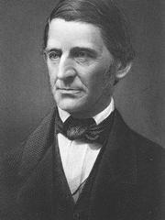
TRANSCENDENTALISM
Middle class
Intellectual, social. literary
R.W. Emerson
“ideal, intuitive reality”
“Transcending” ordinary life
Individual knowledge
“self-reliance”
Nature
Intellectuals and commoners
All could learn
Look inside

Slide 19
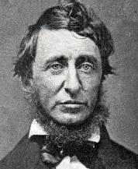
TRANSCENDENTALISM
Thoreau
Individualism
Unique character
Quality of life?
Slavery?
Competitive economy?
Materialism?
Conformity?
Basis of industrial America

