Slide 1
CHAPTER 7
AGRICULTURE/URBAN GROWTH

Slide 2
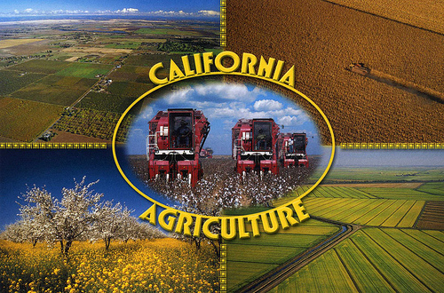
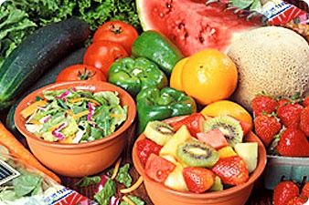
AGRICULTURE
$38 bil.
400 comm.
50% fruits, nuts, veg.
9/10 top producing counties in U.S. (6.6% total economic output)

Slide 3
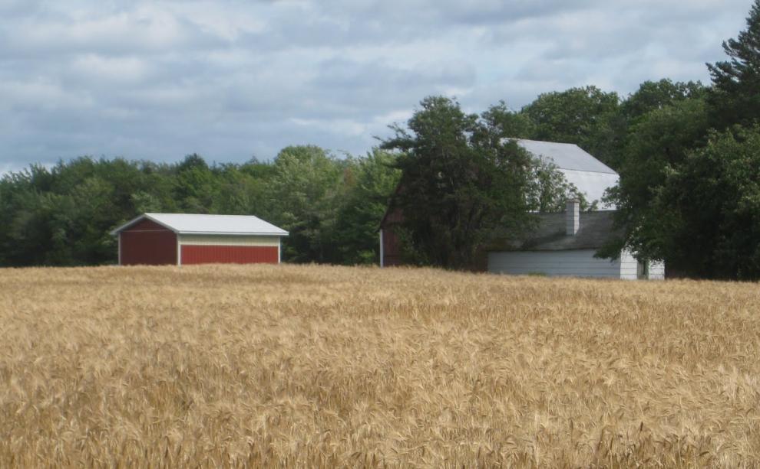
WHEAT
1860-1890: Largest
“bindlemen”
Decline: competition
Shift

Slide 4
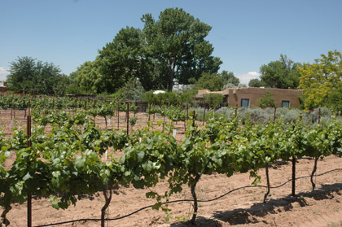
WINE
Missions: poor quality

Slide 7
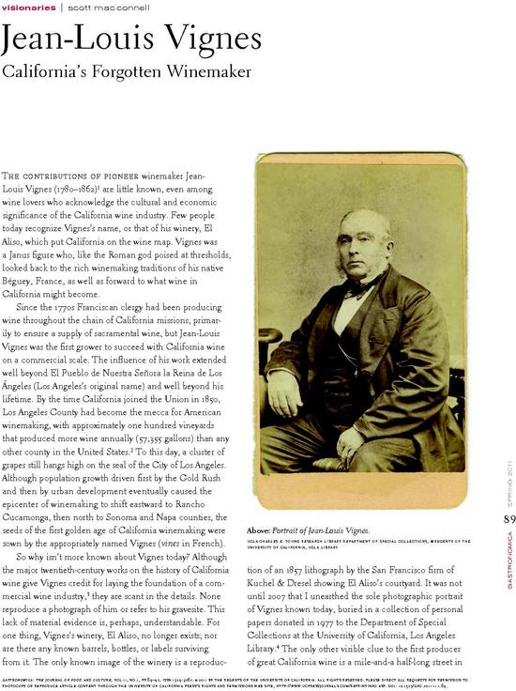
Jean L. Vignes
El Aliso
1830’s, L.A.
1850: Largest production

Slide 8
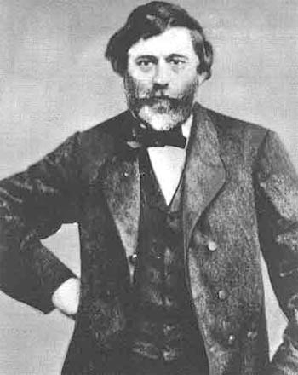
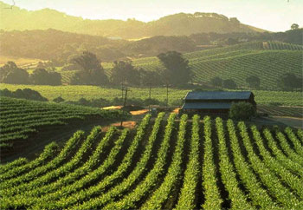
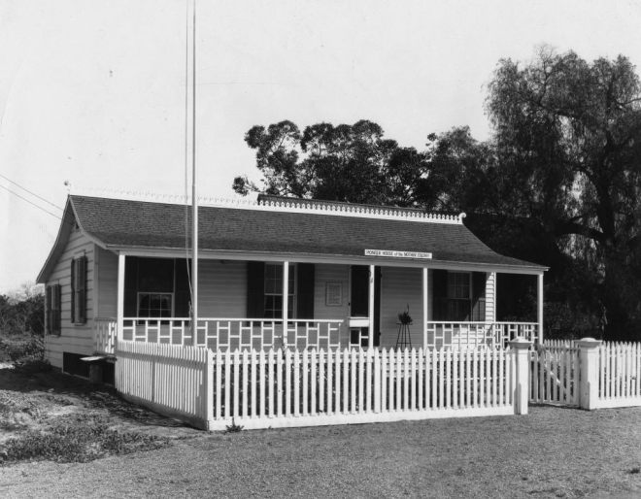
North
1850’s: Agoston Haraszthy, Sonoma Valley
Anaheim: 1857, German

Slide 9
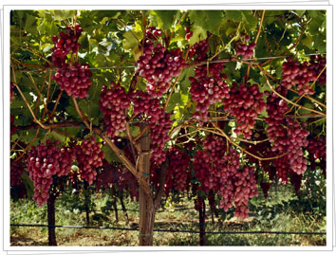
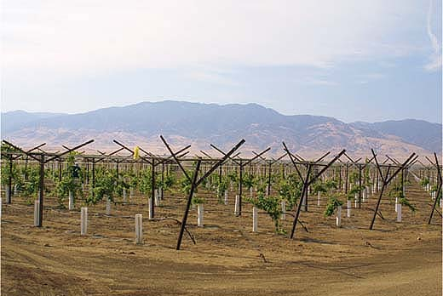
CENTRAL VALLEY
Dessert wines
Table grapes
Raisins

Slide 10
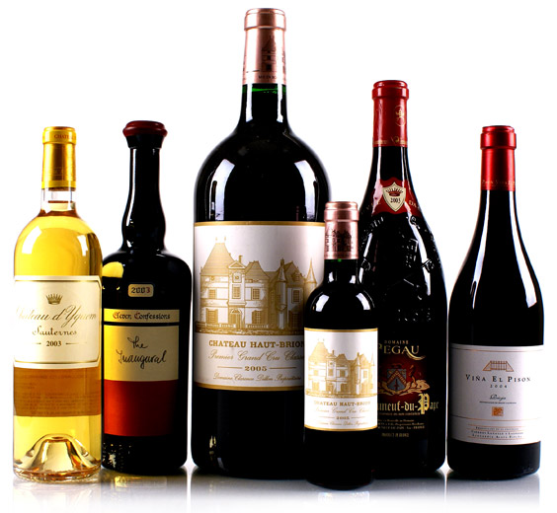
1900: 19 million gal.
80% U.S.

Slide 11
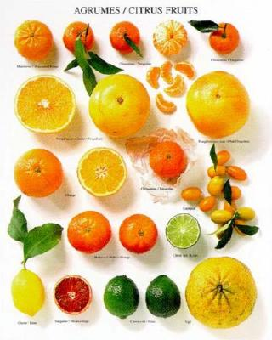
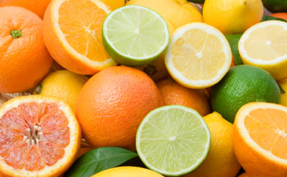
CITRUS (05/06)
2ND
24% oranges, 80% fresh market
87% lemons

Slide 12
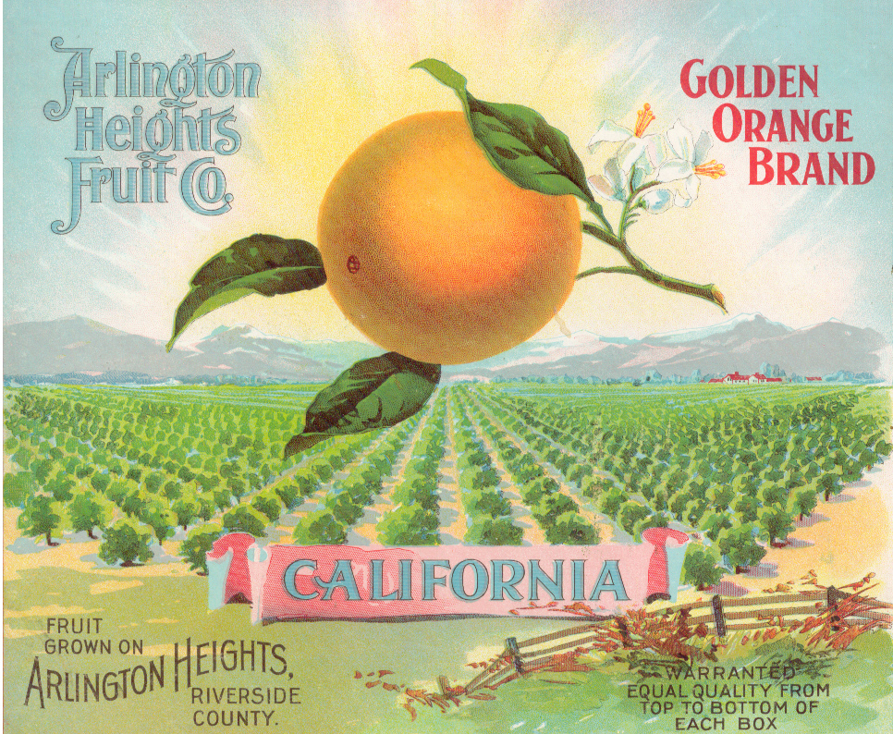
3 DEV.
Location (higher ele., away coast)

Slide 13
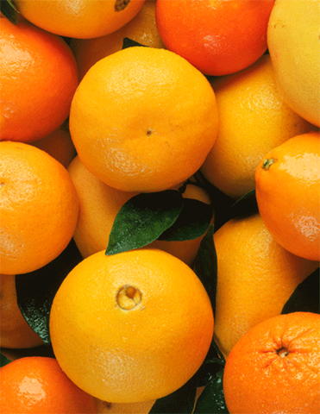
Navel (Brasil)
Seedless, sweeter

Slide 14
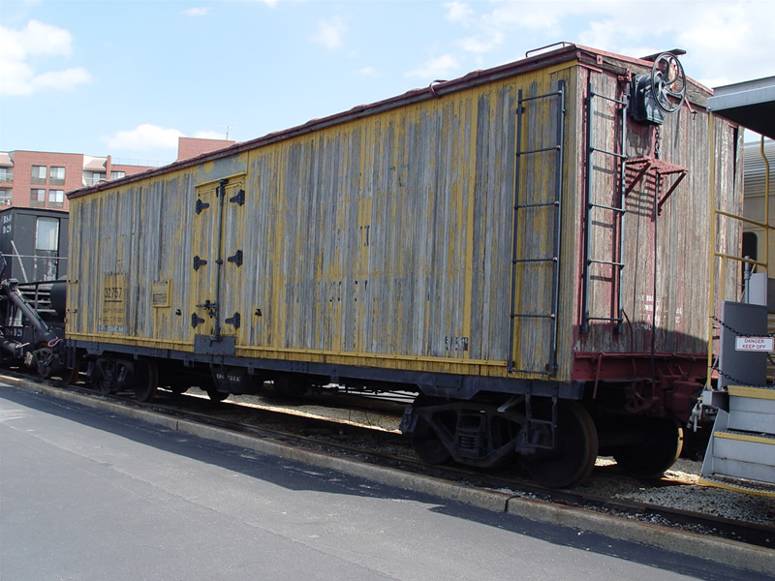
Railroads

Slide 15
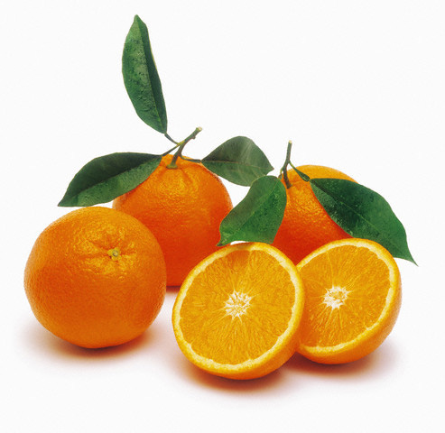
VALENCIA
Coastal
Summer

Slide 16
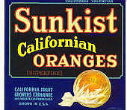
1900: 2/3 oranges, 90% lemons
Sunkist Growers (1925): association

Slide 17
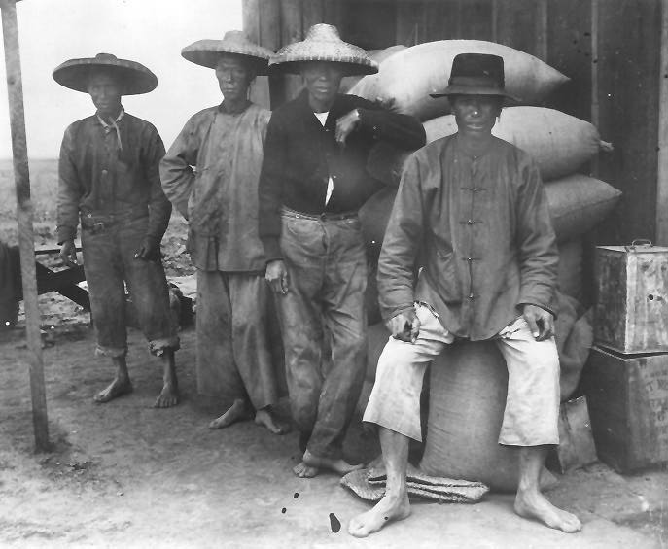
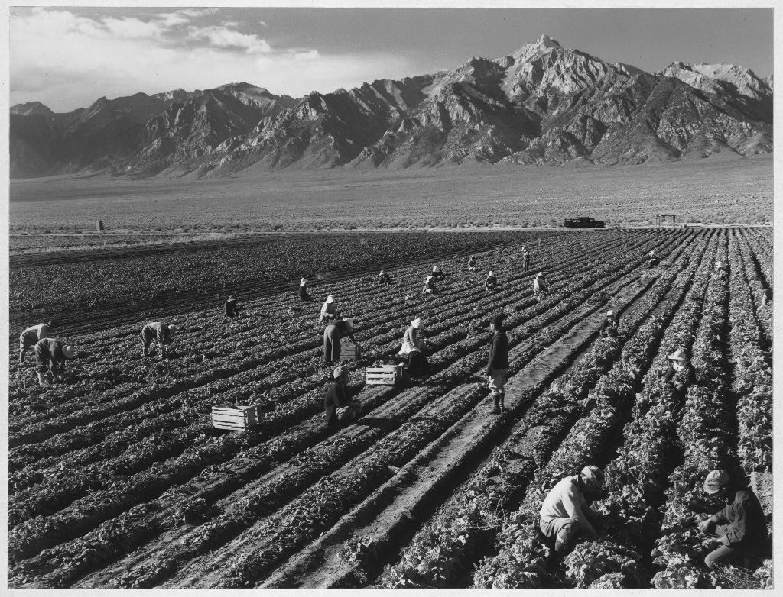
BEHEMOTH
Agriculture to “agribusiness”
Cheap labor: Chinese
Then Japanese, Mexican
Contentious relations

Slide 18
CHINESE LABOR
“built” agr. industry
Irrigation, canals, etc.
1880
86% Sac. Co.
85% Yuba

Slide 19
JAPANESE FARMERS
1910: 70% strawberries
1920: 10% crops CA

Slide 21
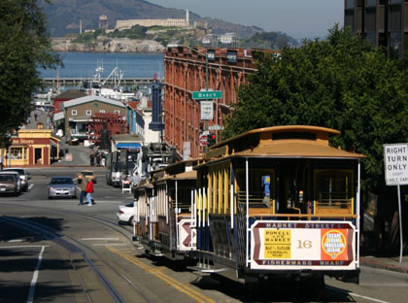
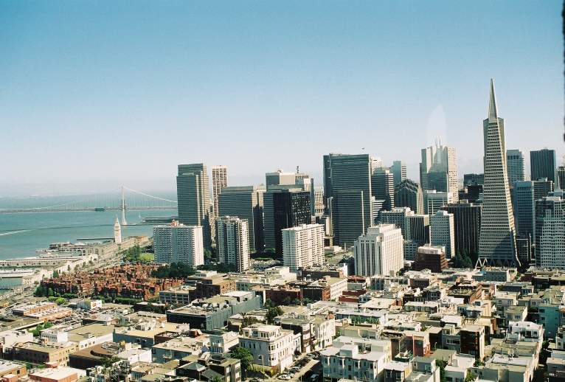
URBANIZATION
S.F.++
Surrounding areas

Slide 22
SO. CAL.
Citrus
“health rush”: better health
1880’s +
Railroad comp.: advertising

Slide 23
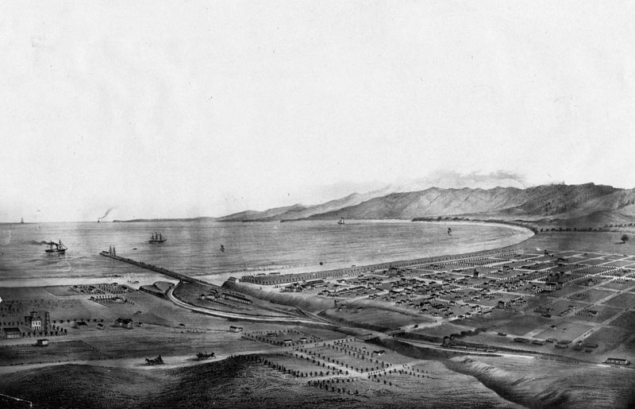
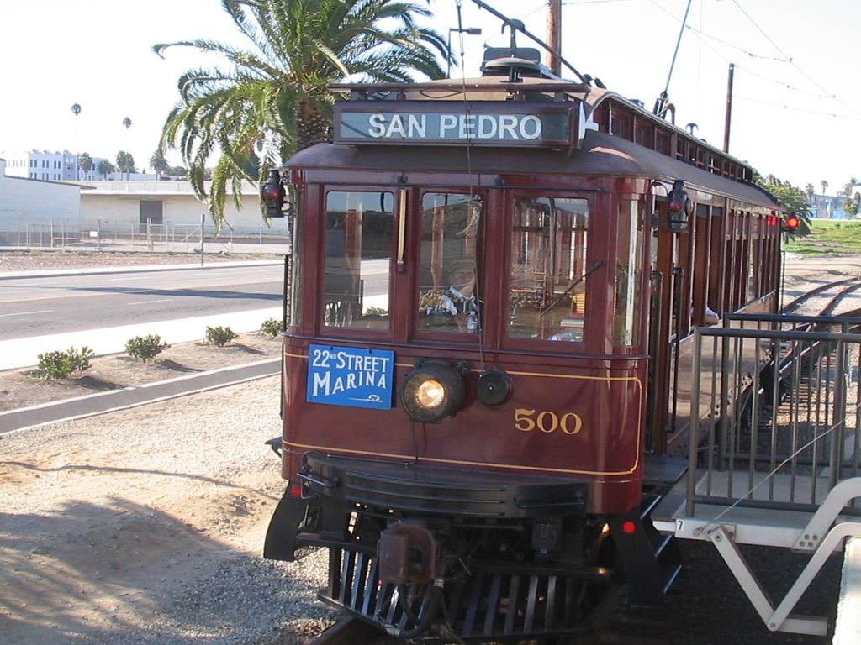
ELECTRIC RAIL
Largest in world

Slide 25
OIL
E. Doheny: L.A.

Slide 26
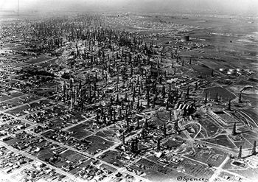
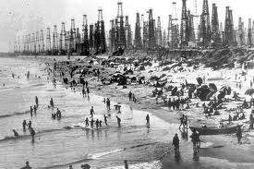
SPREAD
1920’s
H.B., SFS
Signal Hill: richest barrel/acre
More than gold, $2.5 bil. 1920’s

Slide 27
CARS
Significance?

Slide 28
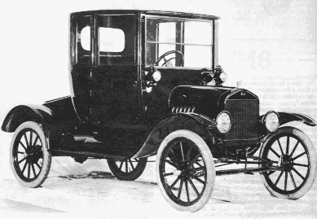
1900: 4k
$$$
1908: Model T

Slide 29
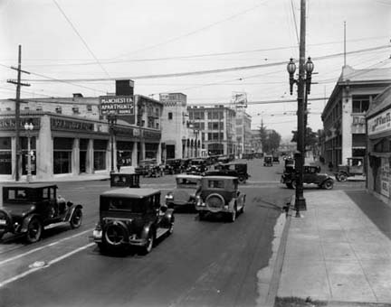
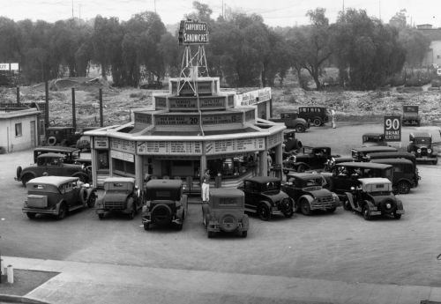
1925
1 in 3: cars
L.A.: most motor-conscious

Slide 30
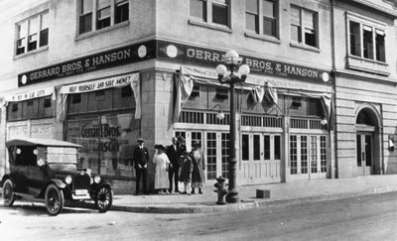
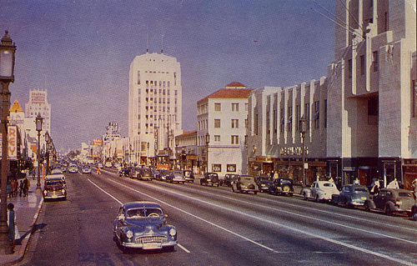
IMPACT?
Expansion, suburbs, spread
“supermarket”
“Miracle Mile”- for cars

Slide 31
Tourism
Service stations

Slide 33
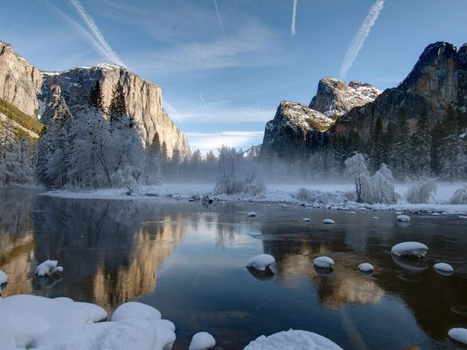
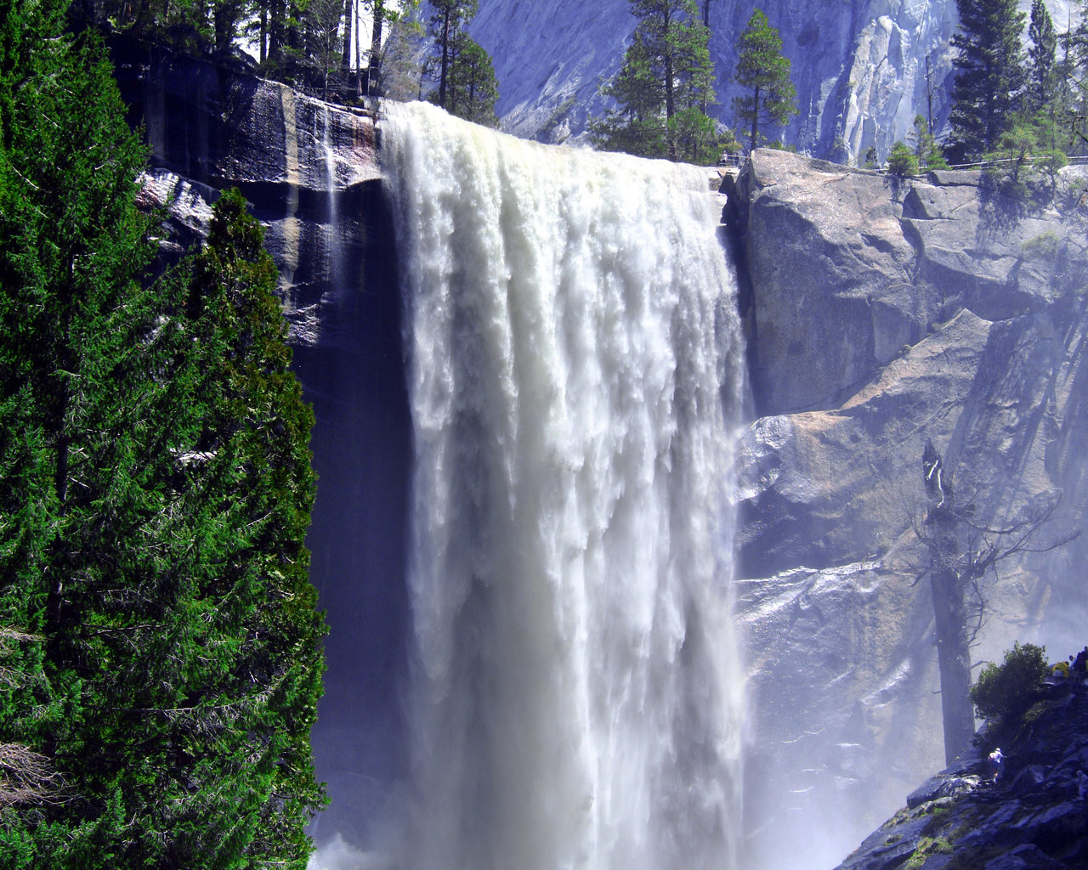

Slide 34
First “park”
Valley to Ca

Slide 35
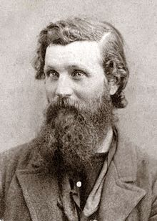
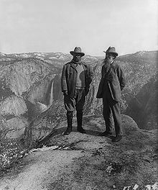
J. MUIR
Naturalist
Conservation
“natural state”
Sierra Club (1892)

Slide 36
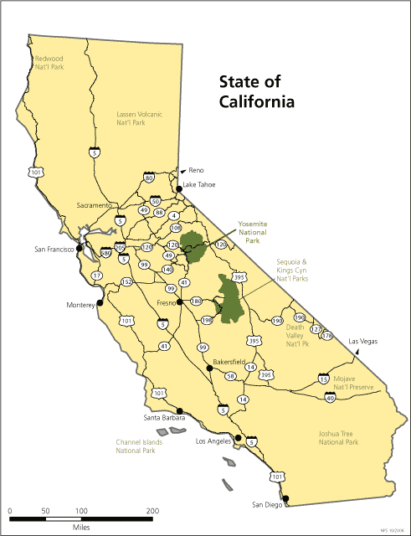
1905: Yosemite Val. back to U.S.

Slide 37
Sequoia, Kings Canyon

Slide 38
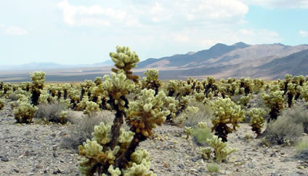
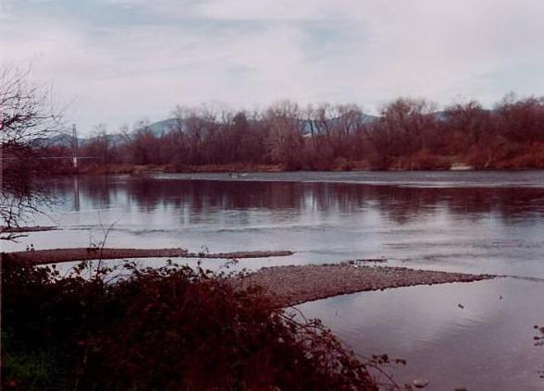
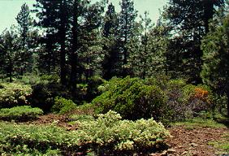
WATER =$$$

Slide 39
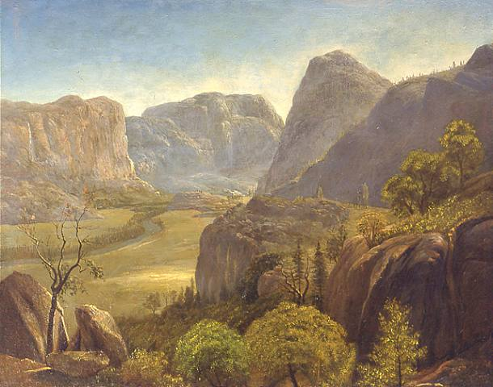
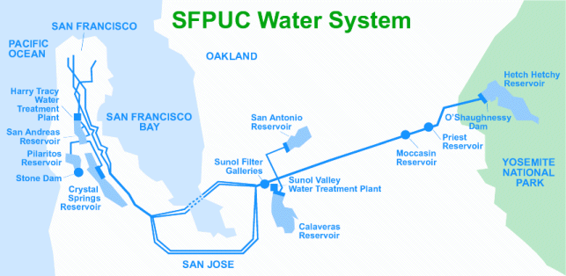
Hetch Hetchy Valley
SF
Muir, Sierra

Slide 40
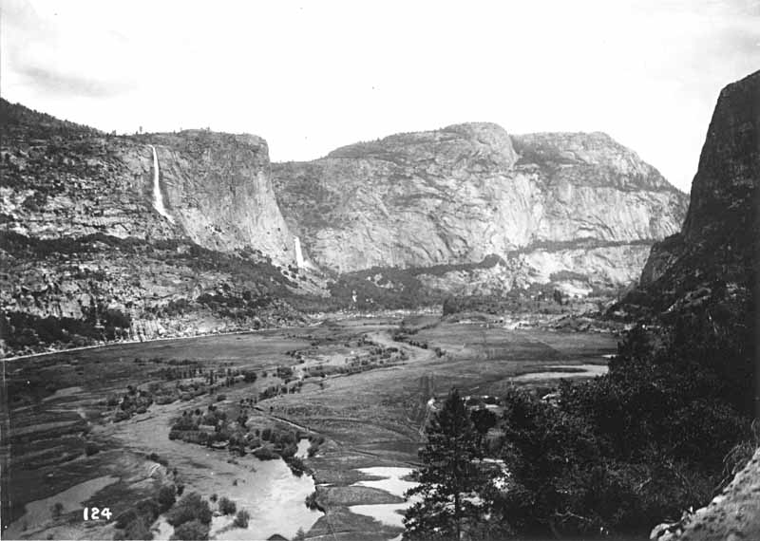

Slide 41
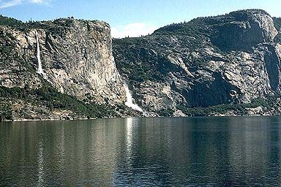

Slide 42
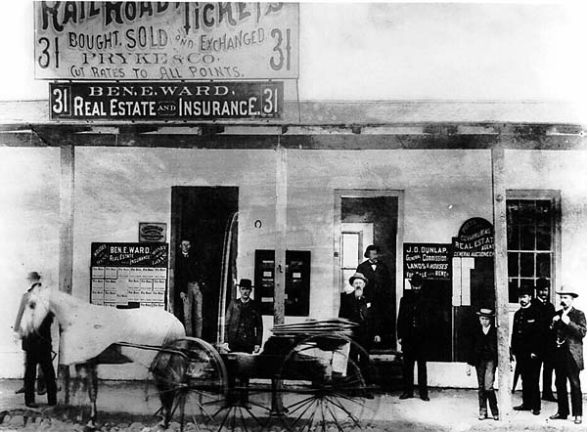
LA?
So Cal dry
natural water 200k people.

Slide 43
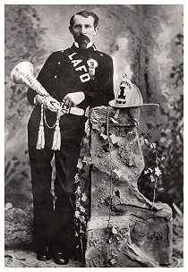
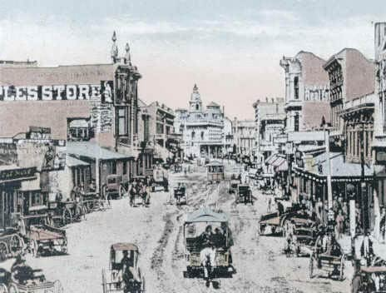
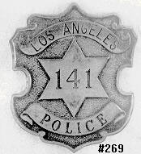
Land+

Slide 44
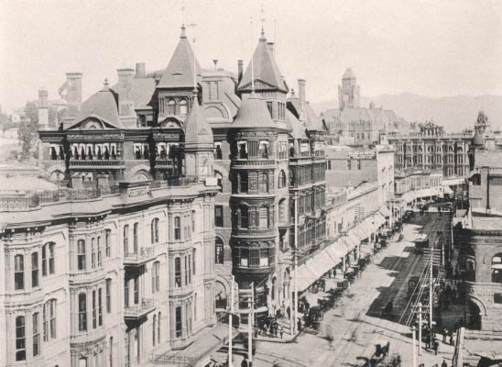

Slide 45
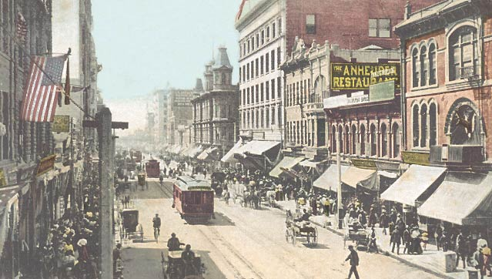
Pop.+

Slide 46
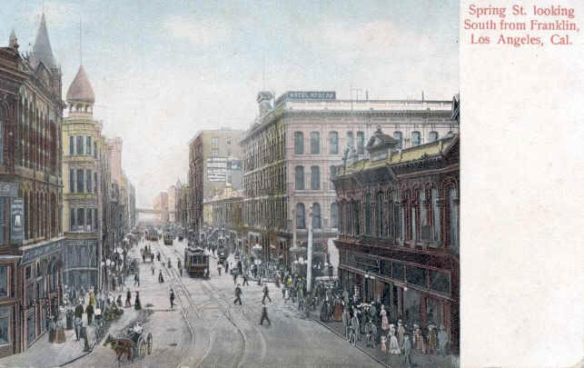

Slide 47
???
Water

Slide 48
Owens River

Slide 49
Aqueduct

Slide 50
Dynamiting

Slide 51
COLORADO RIVER

Slide 52
Hoover Dam

Slide 53
Las Vegas

