Slide 1
CHAP. 8

Slide 2
PROGRESSIVES
Reform
Change
Corruption, environment

Slide 3
GOOD GOVT. MOVEMENT
Business+ethics

Slide 4
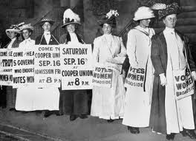
SUFFRAGE
Women, 1911
2% margin

Slide 5
MORALS
Anti-saloons
Racetrack gambling
1913: illegal brothels

Slide 6
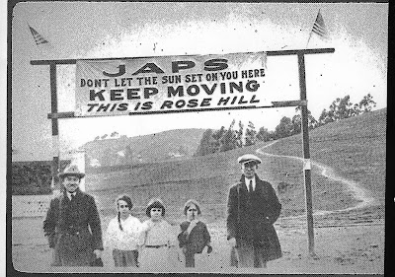
ANTI-JAPANESE

Slide 8
Recall: Workingmen’s, 1877

Slide 9
WORK

Slide 10
WORKERS
Harsh conditions
12-18 hrs., 7 days: S.F. bakers

Slide 11
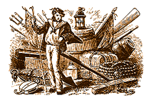
UNIONS – S.F.
Sailors
could not quit, corporal punishment
Closed shop by 1915
Strong Unions

Slide 12
L.A.
Open shop
No bargaining w/Unions
No change until Dep.

Slide 13
FARM WORKERS
Worse conditions
No rights
Ralph Durst
Little housing
Unsanitary
100 degrees, no water

Slide 14
Organization
Slow

Slide 15
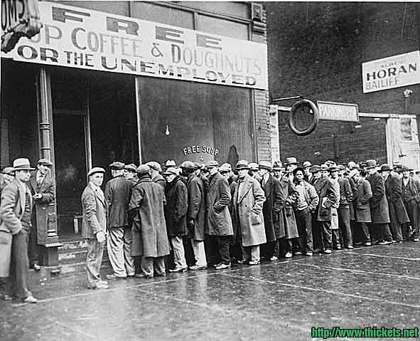
ECONOMY
Declining by 1926

Slide 16
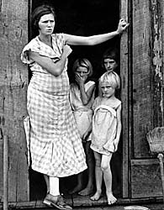
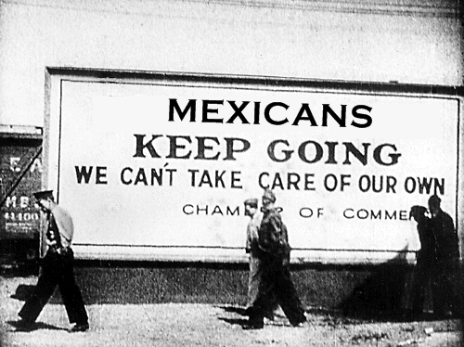
SOCIETY
Children malnourished
Mexicans – deported
Lost wages, homes

Slide 17
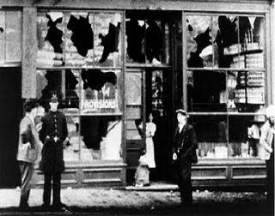
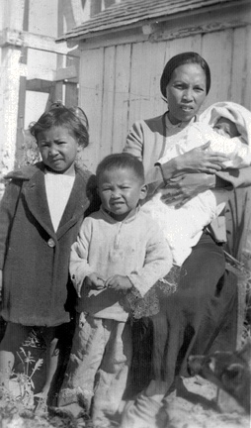
Ethnic antagonism
Filipinos
1898
1940: 2/3 in CA
Rioting, murder
Fears?
Economics
Socializing w/White women

Slide 18
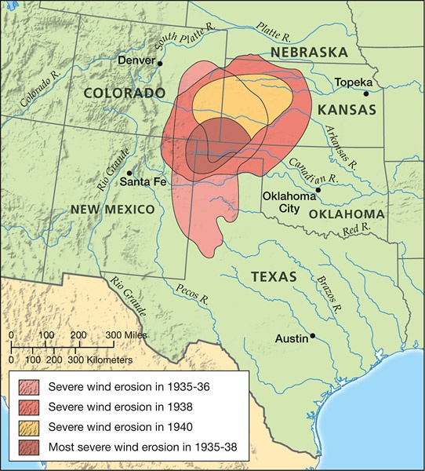
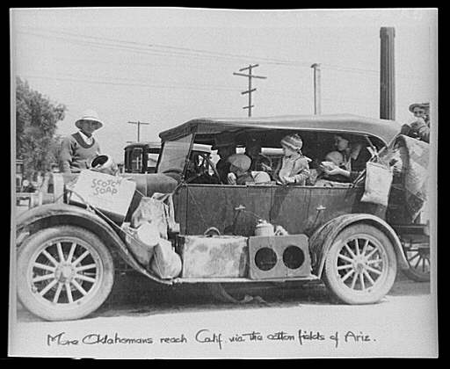
OKIES
Dust Bowl

Slide 19
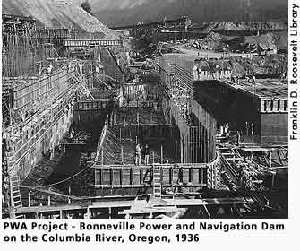
Govt. help
PWA: federal build., bases
WPA: roads, parks

Slide 20
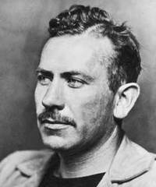
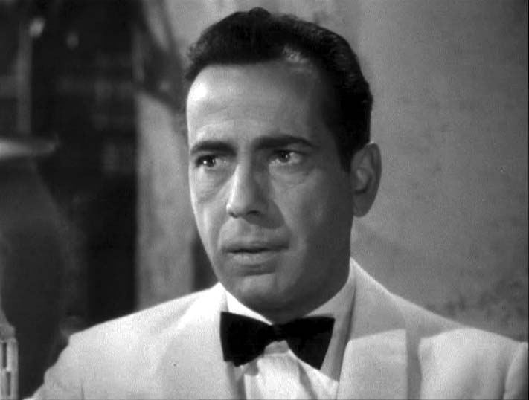
CULTURE
J. Steinbeck
Wrath
Films
Maltese Falcon

Slide 21
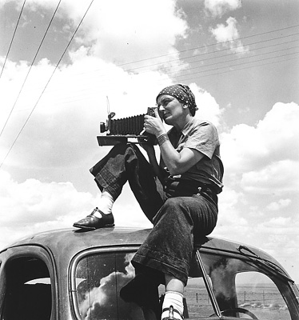
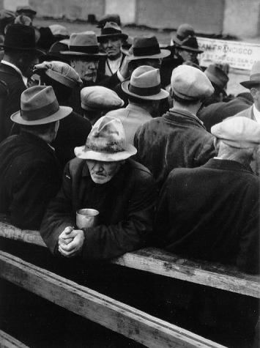
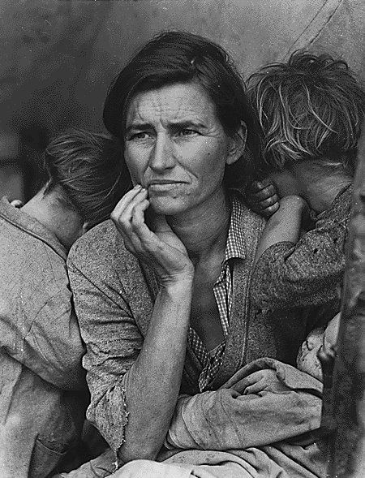
photos
Dorothea Lange
Victims

Slide 22
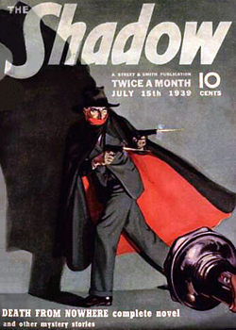
RADIO
70%
Entertainment

