Slide 1
DEPRESSION WW2
30

Slide 2
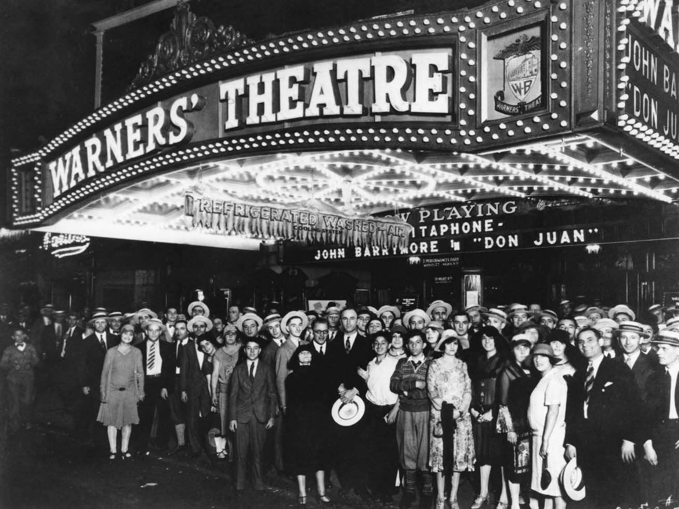
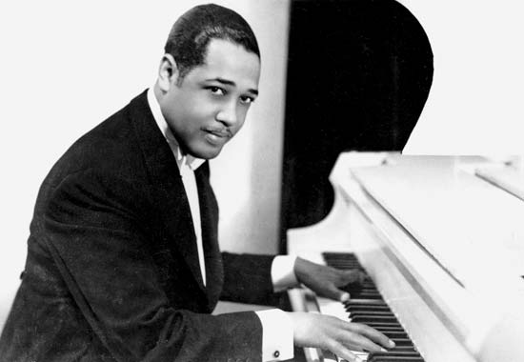
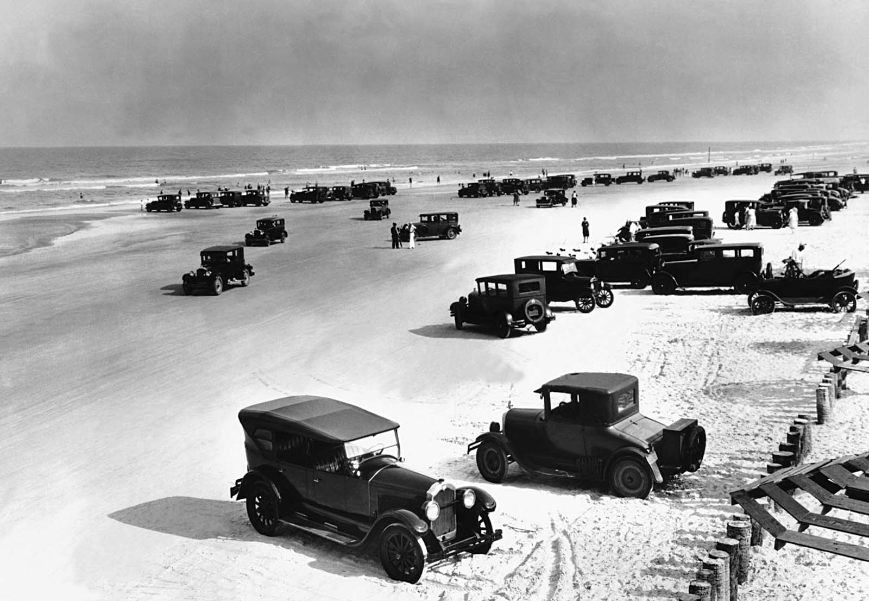
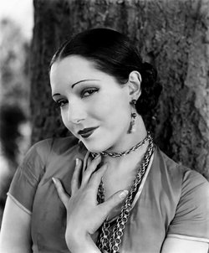
20’s
Autos
Film
Jazz

Slide 3
WOMEN
-jobs
+suffrage

Slide 4
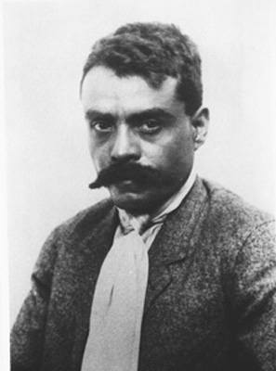
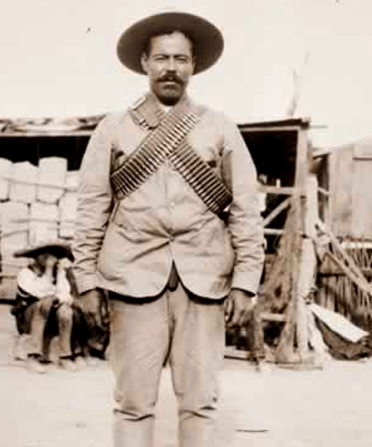
Revolution
Civil war

Slide 5
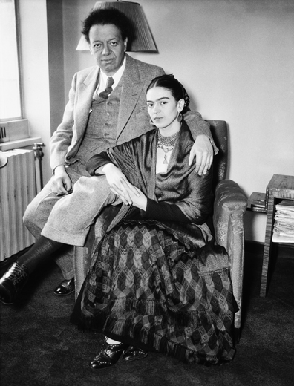
“Indianize”
Diego Rivera
Anti-west, capitalism

Slide 6
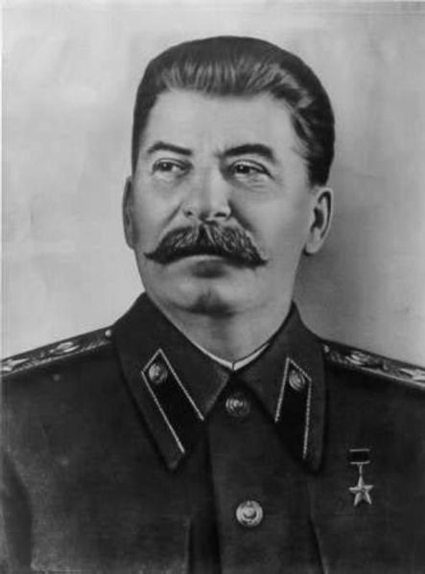
Bolsheviks
Stalin
1930’s
Dictator

Slide 7
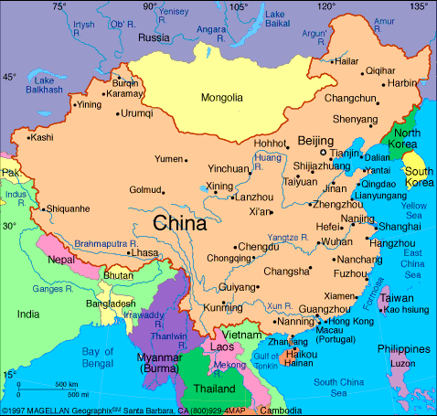
2 factions

Slide 8
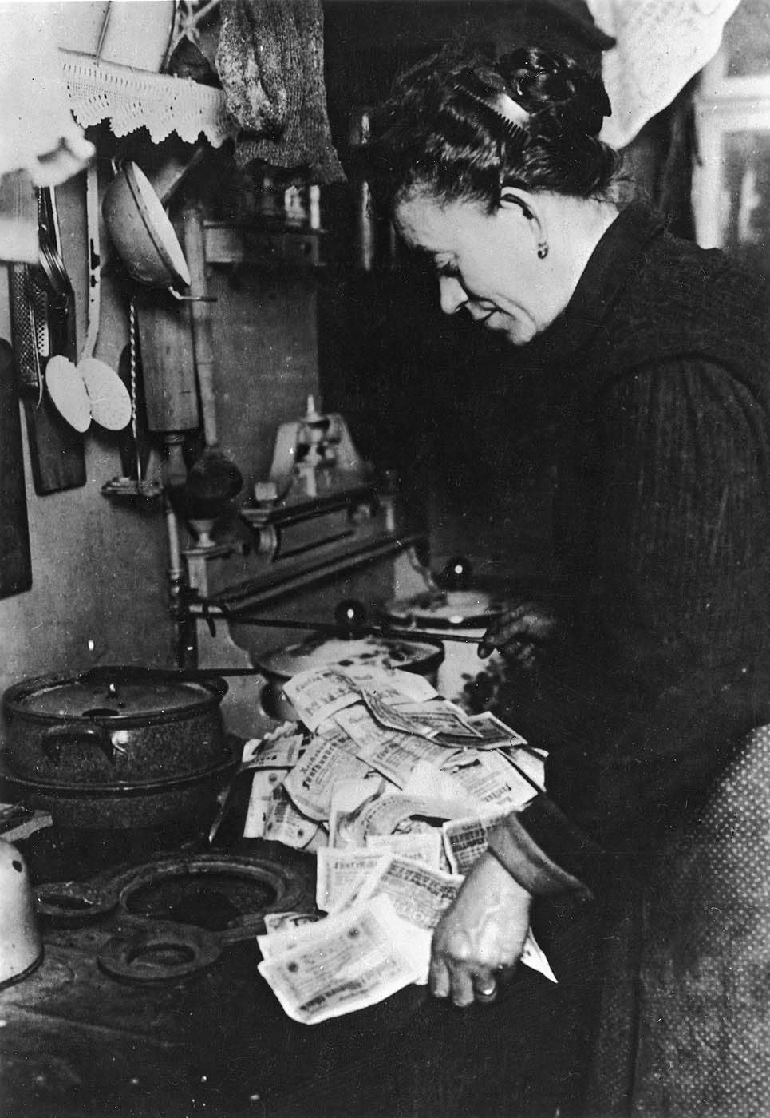
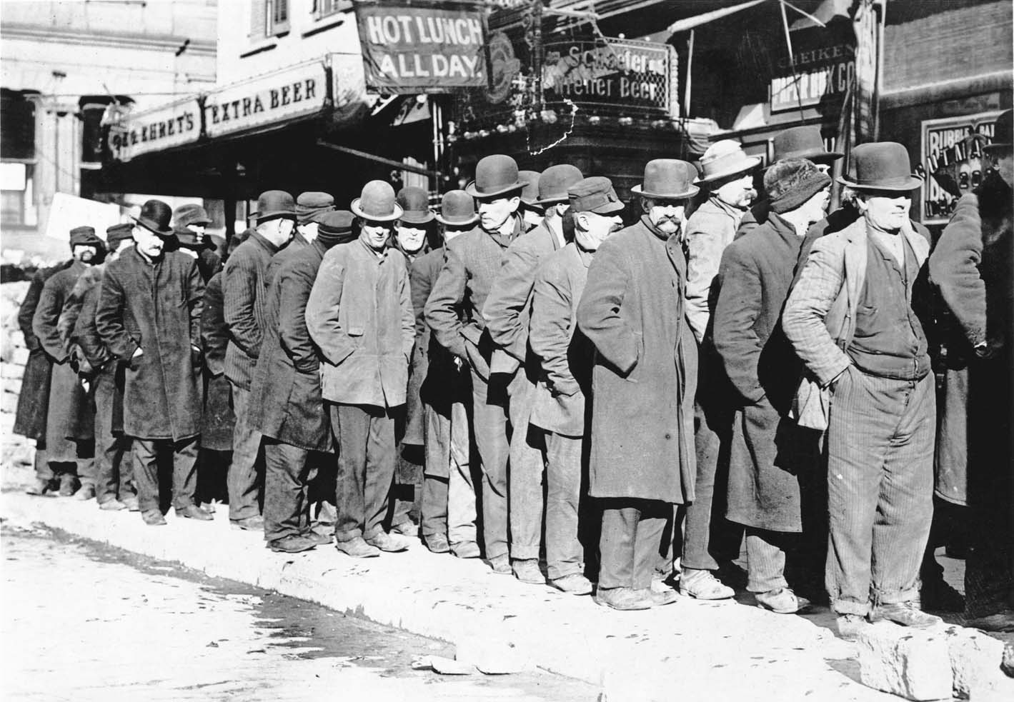
DEPRESSION
?
+ products
Prices –
Unemployment
Global?

Slide 9
Soviet Union
Immune

Slide 10
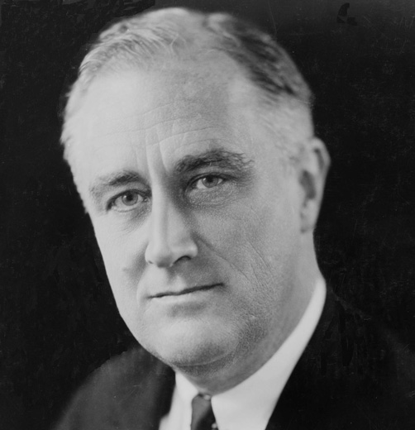
CONSEQUENCES
The New Deal
U.S.

Slide 11
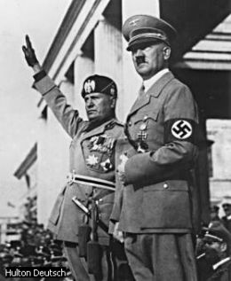
+ Fascism

Slide 12
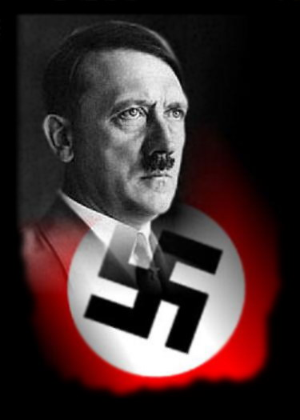
Anti-semitic
Totalitarian

Slide 13
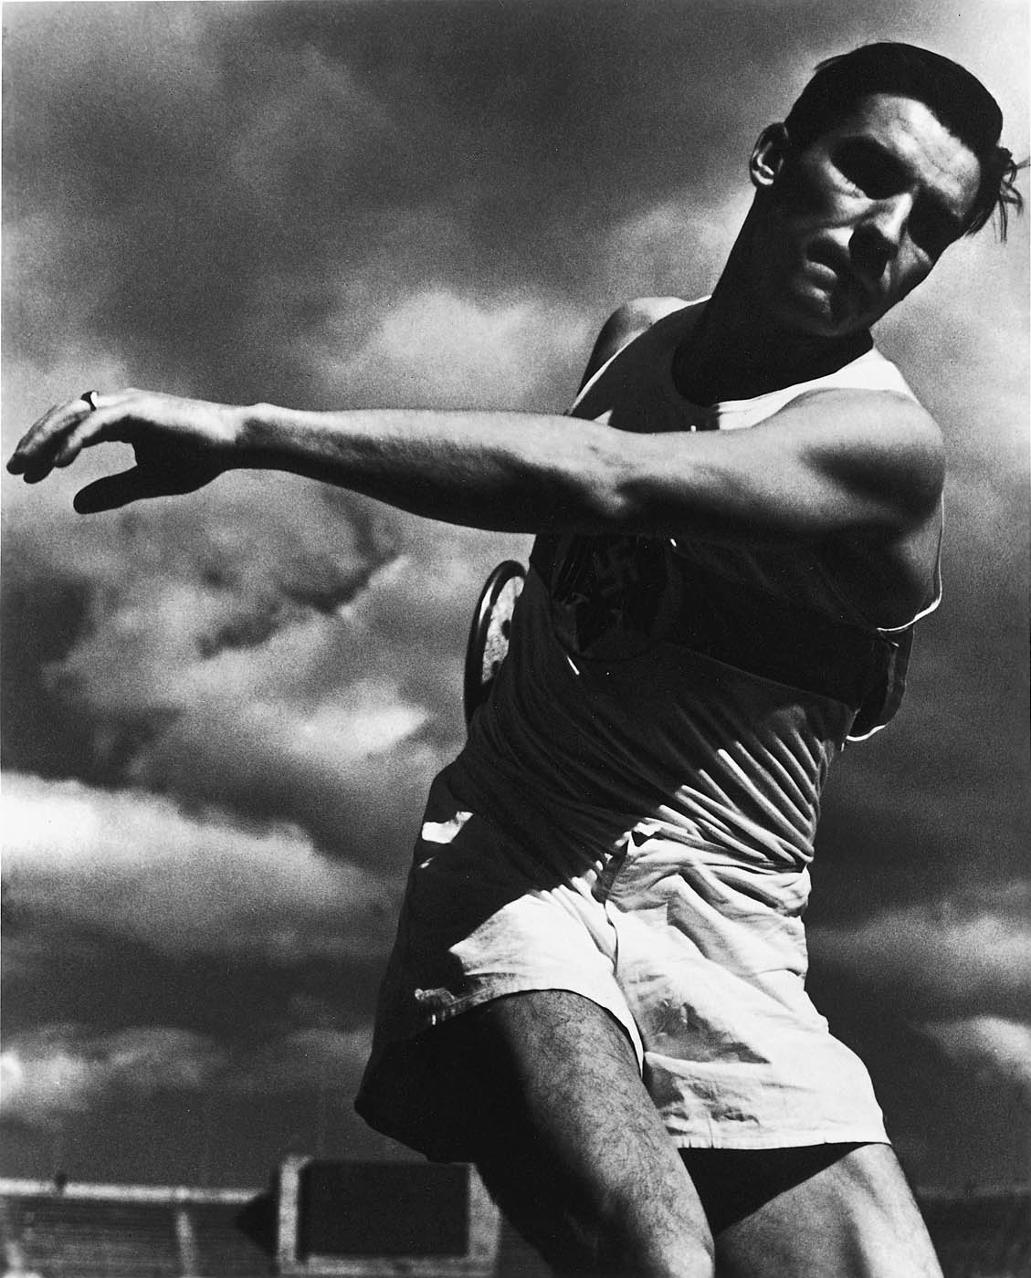
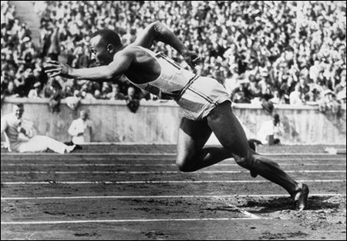
“Aryan” supremacy
1936 Olympics

Slide 15
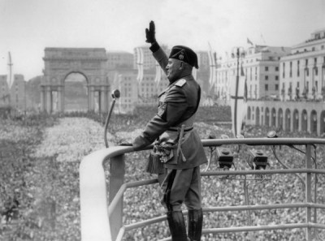

Slide 16
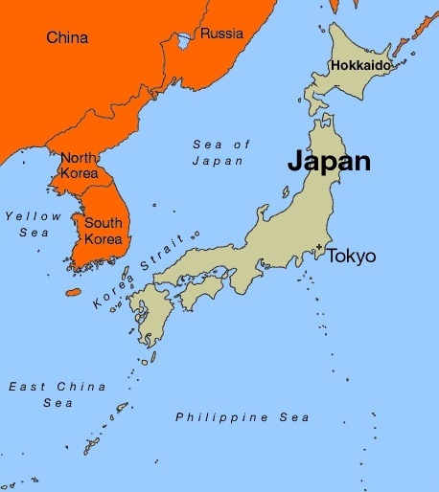
Nationalists
Ambitions

Slide 17
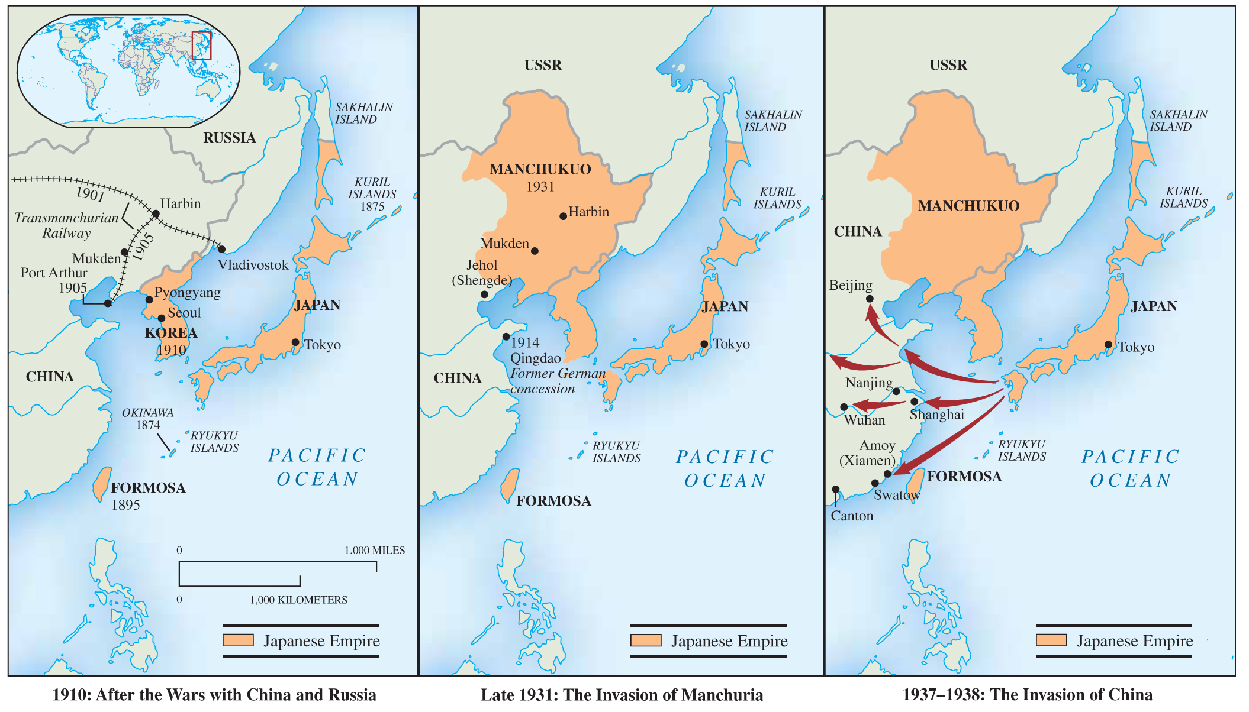

Slide 19
Origins
WWI
Economics
Expansion

Slide 20
FASCISM

Slide 22
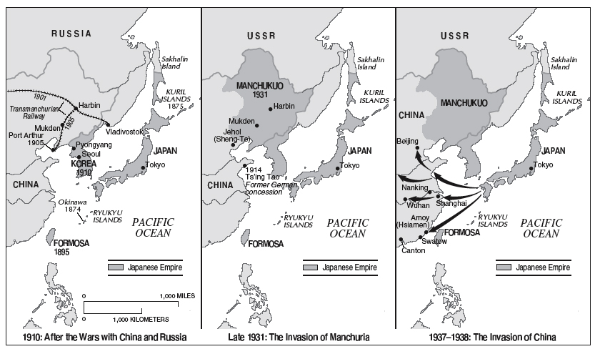
War
Japan

Slide 23
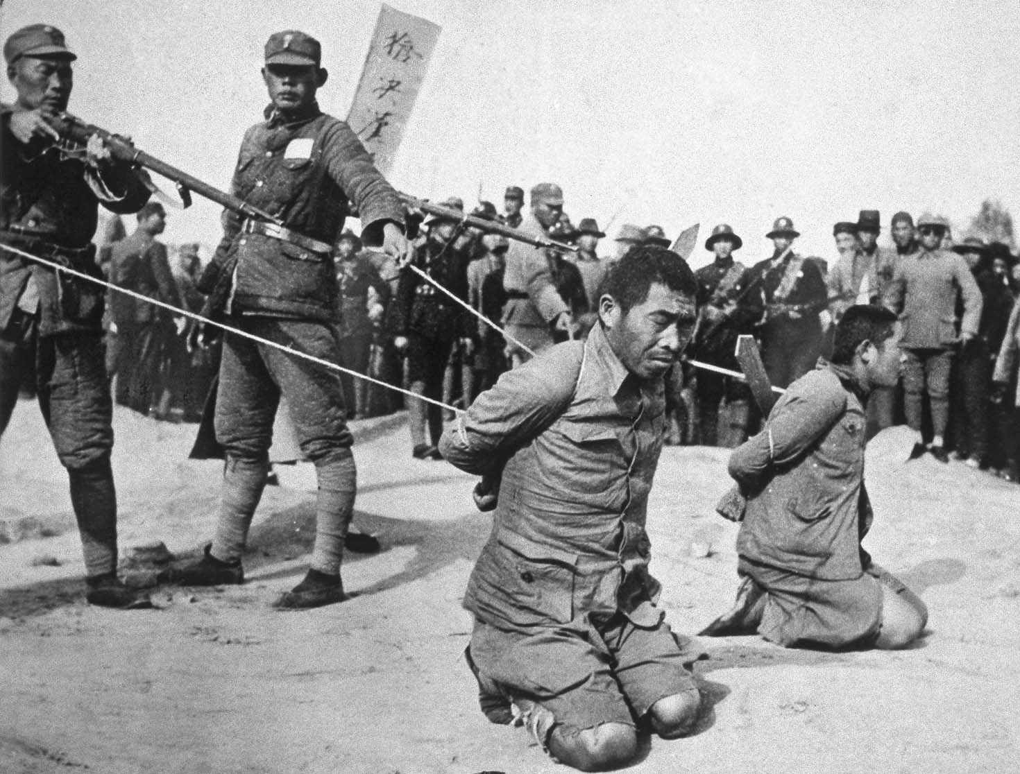
RAPE OF NANKING
Dec 1937

Slide 26
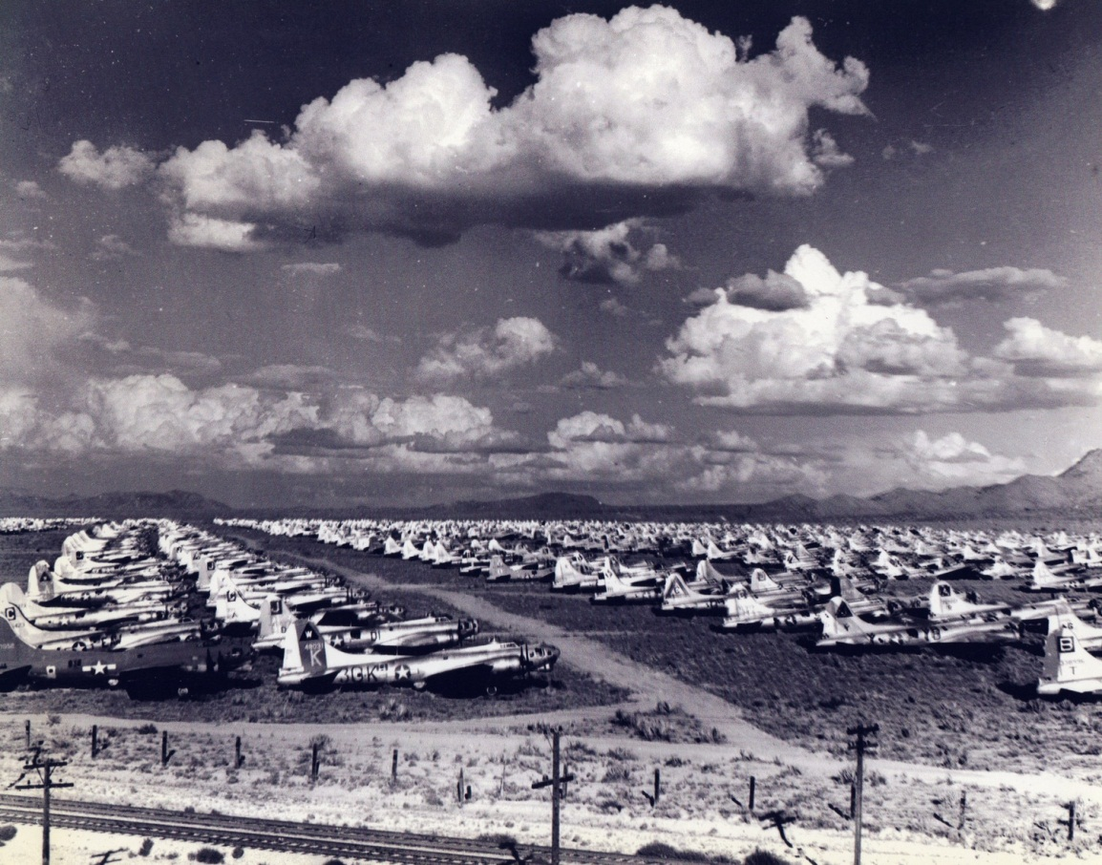
Costs
1938: Japan 70% budget
Aircrafts +++

Slide 27
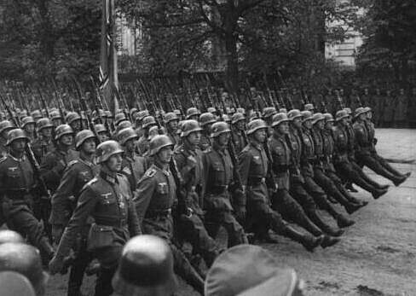
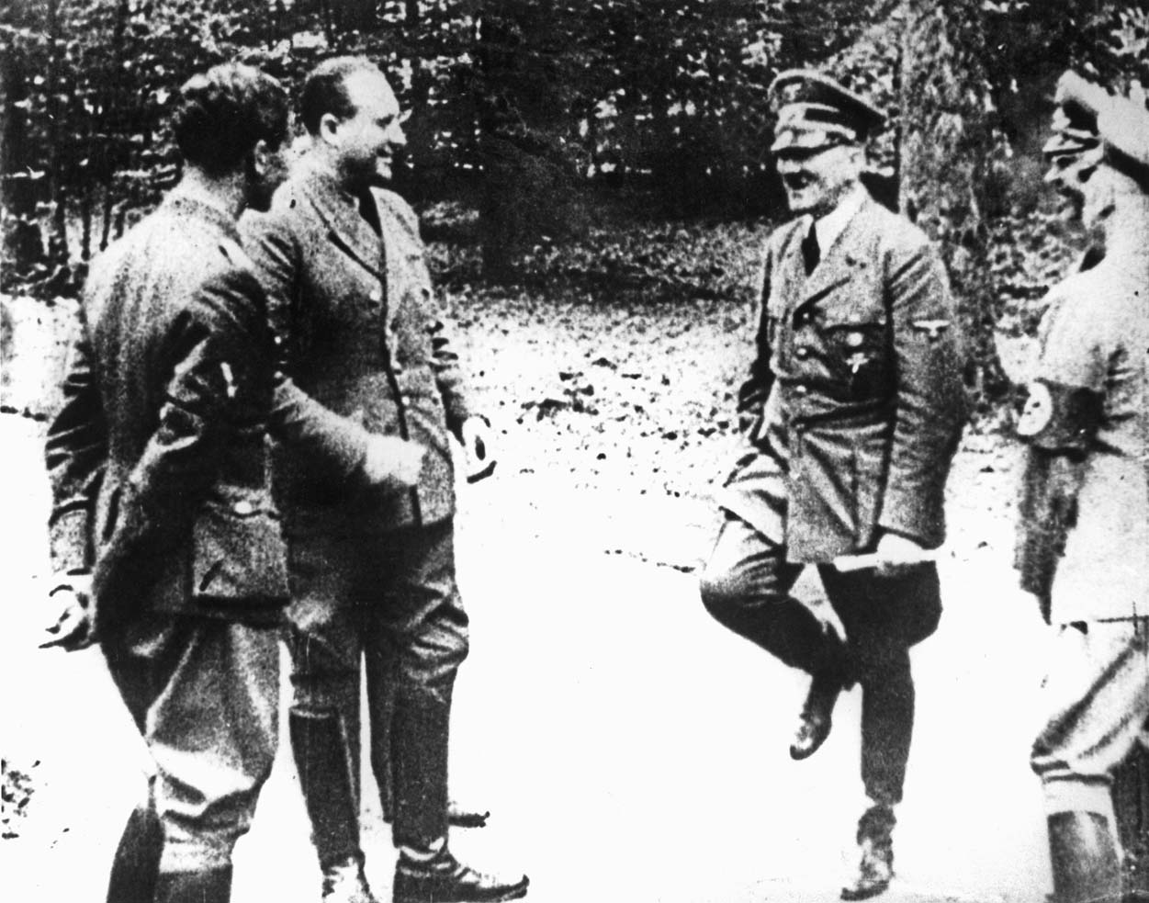
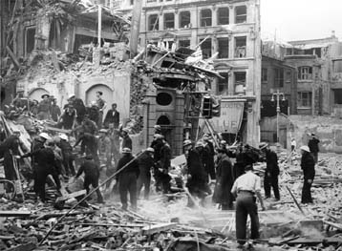
war
Germans
Blitzkrieg:

Slide 28
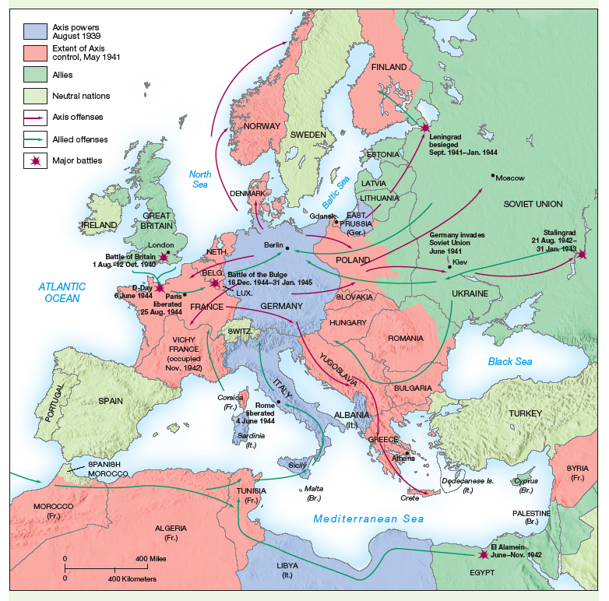

Slide 29
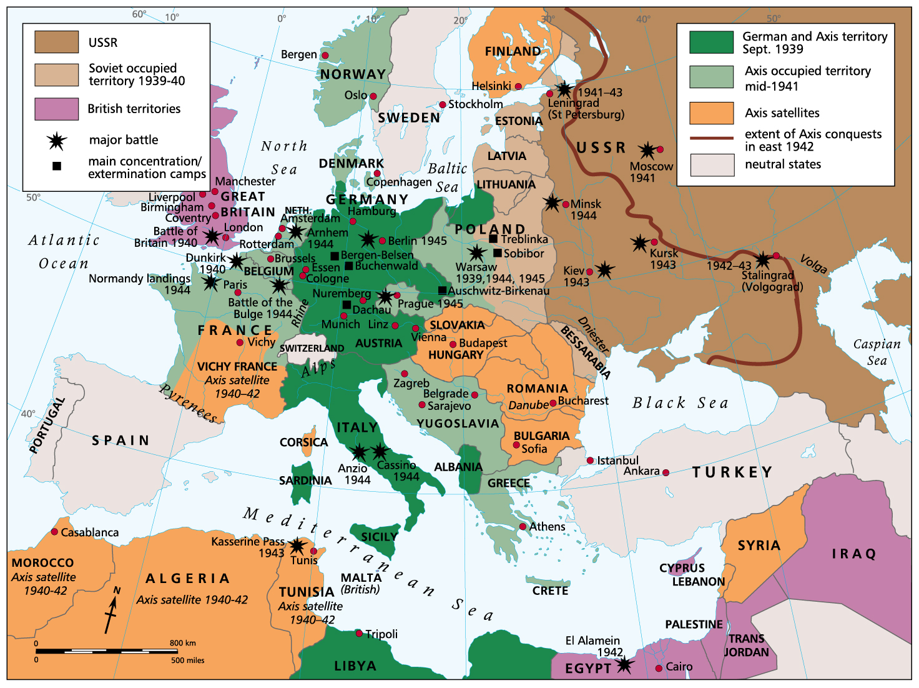

Slide 30
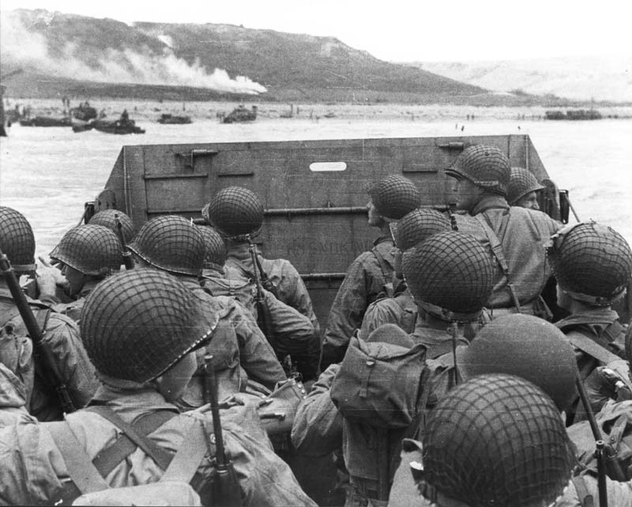
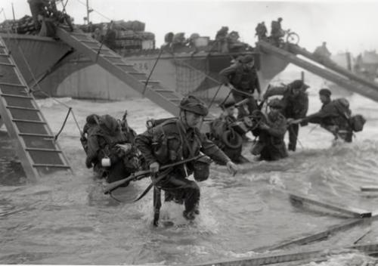
D-Day (1944)

Slide 32
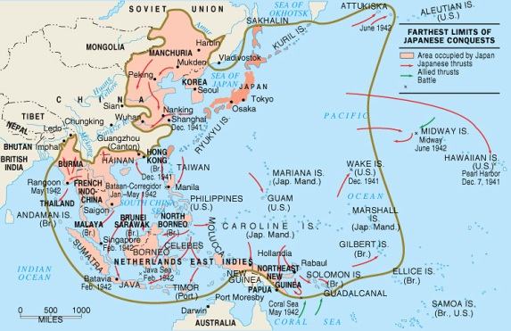
Japanese expansion

Slide 33
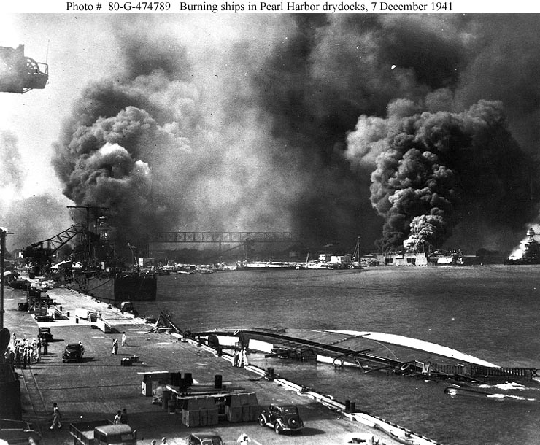
U.S. vs. Japanese
Pearl Harbor

Slide 35
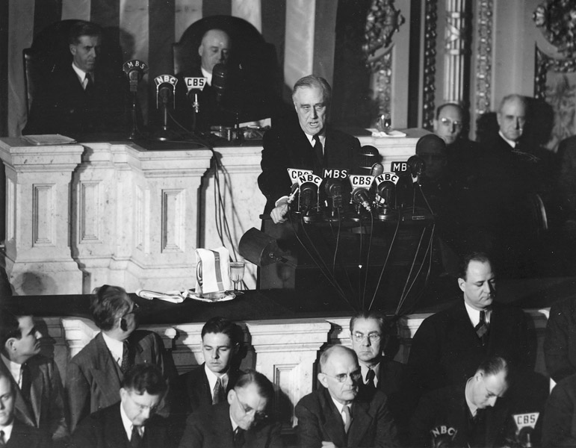

Slide 36
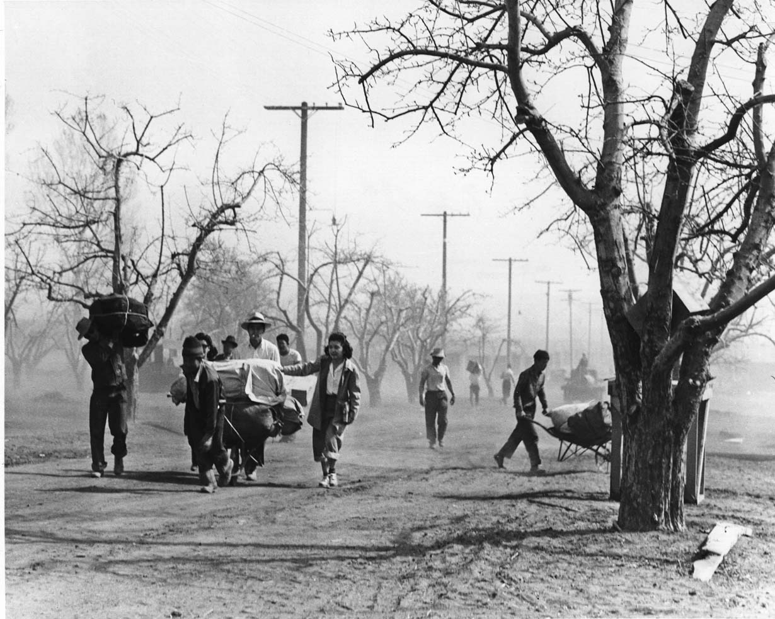

Slide 37
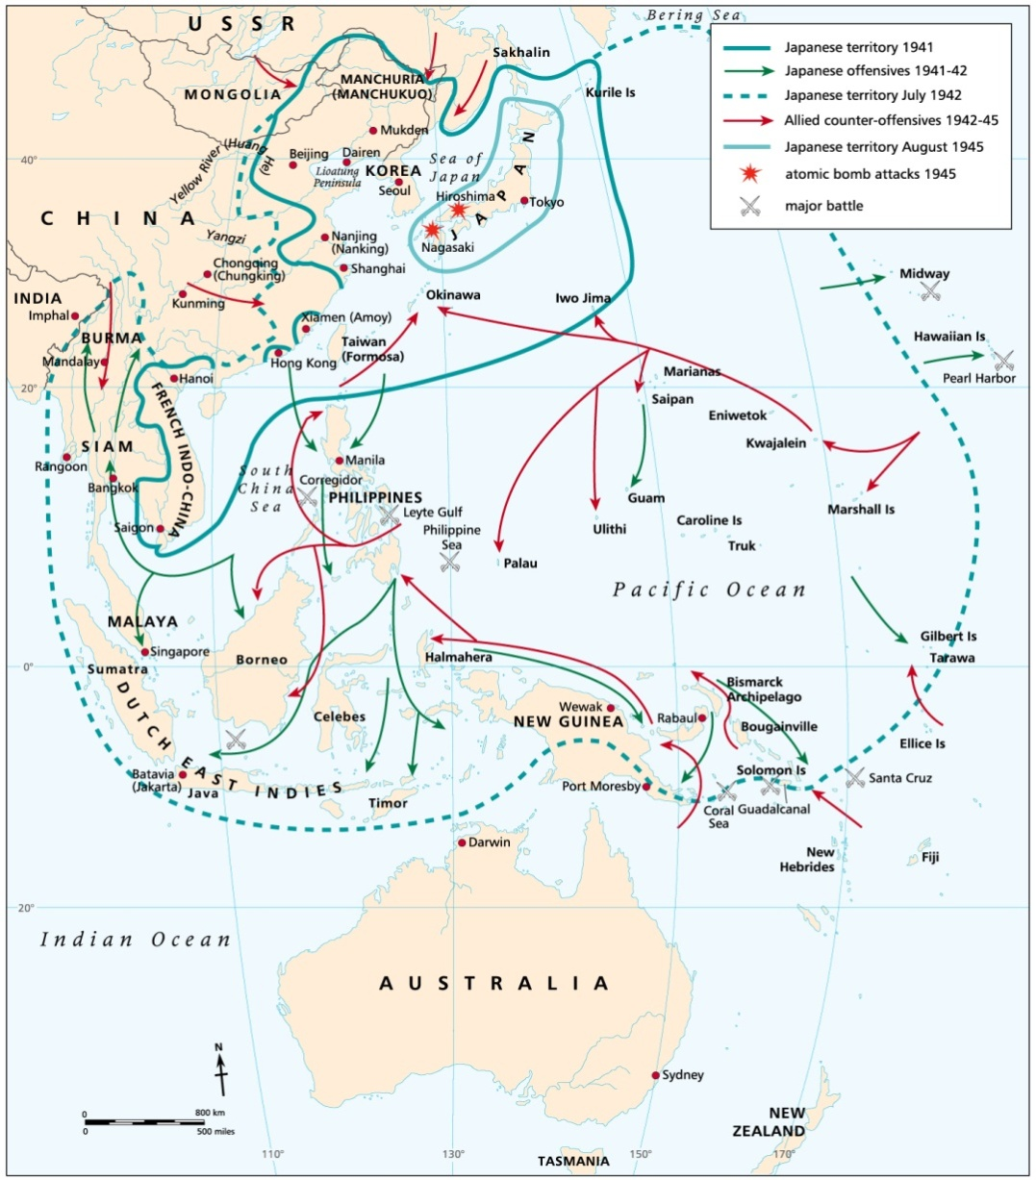
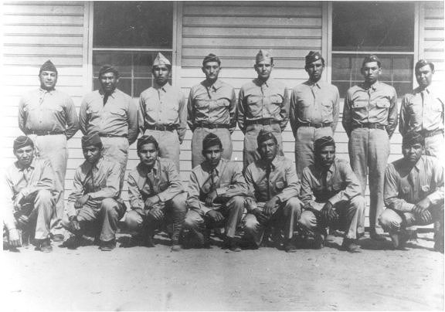
Japan
Initial victories
U.S.
“Magic”

Slide 38
AXIS DEFEAT

Slide 39
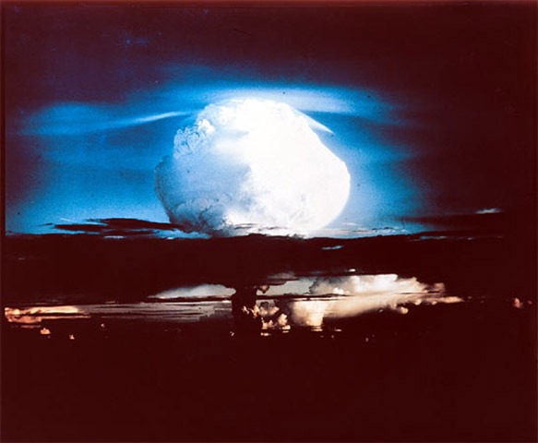
Atomic bomb
Manhattan project
$2 bil.

Slide 40
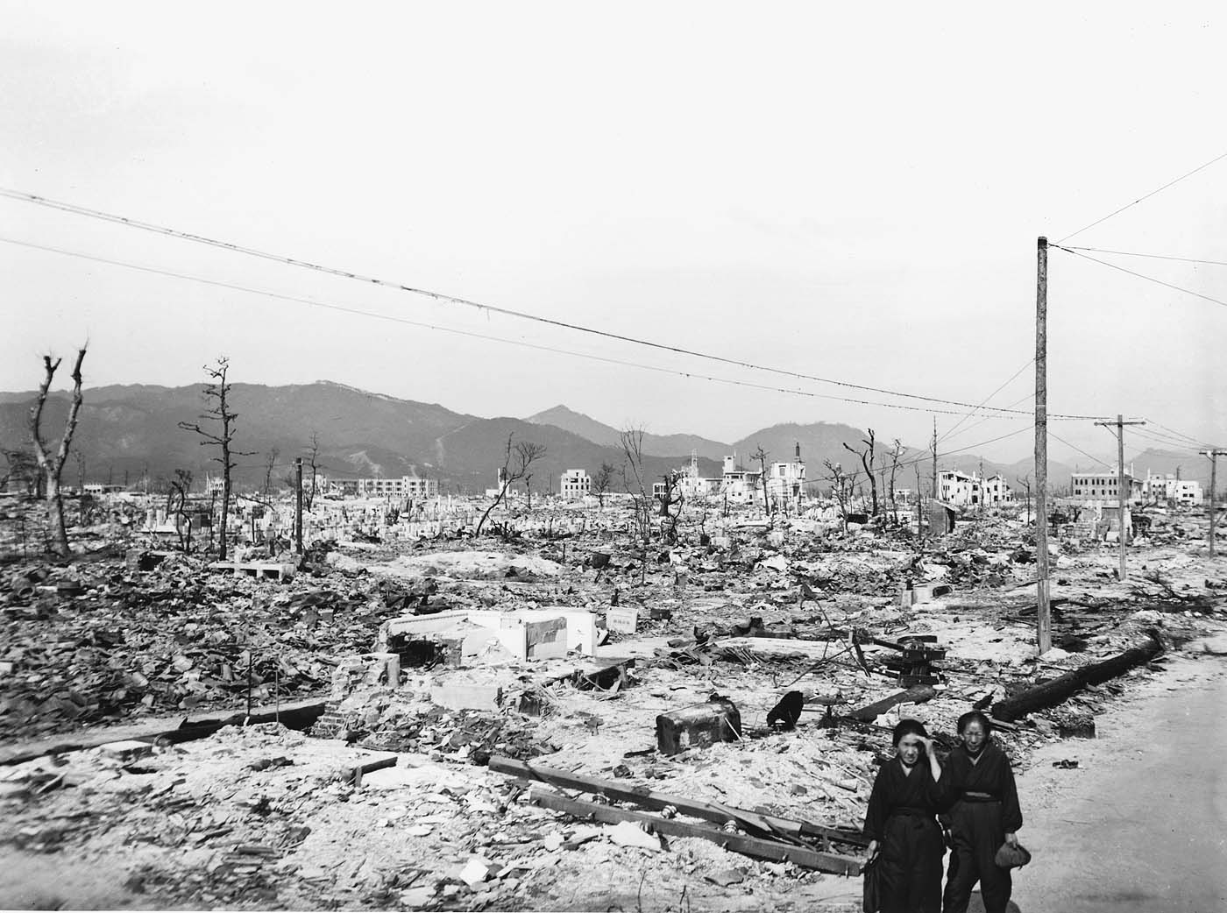
Japan surrenders

Slide 41
Mobilized
New freedoms

Slide 42
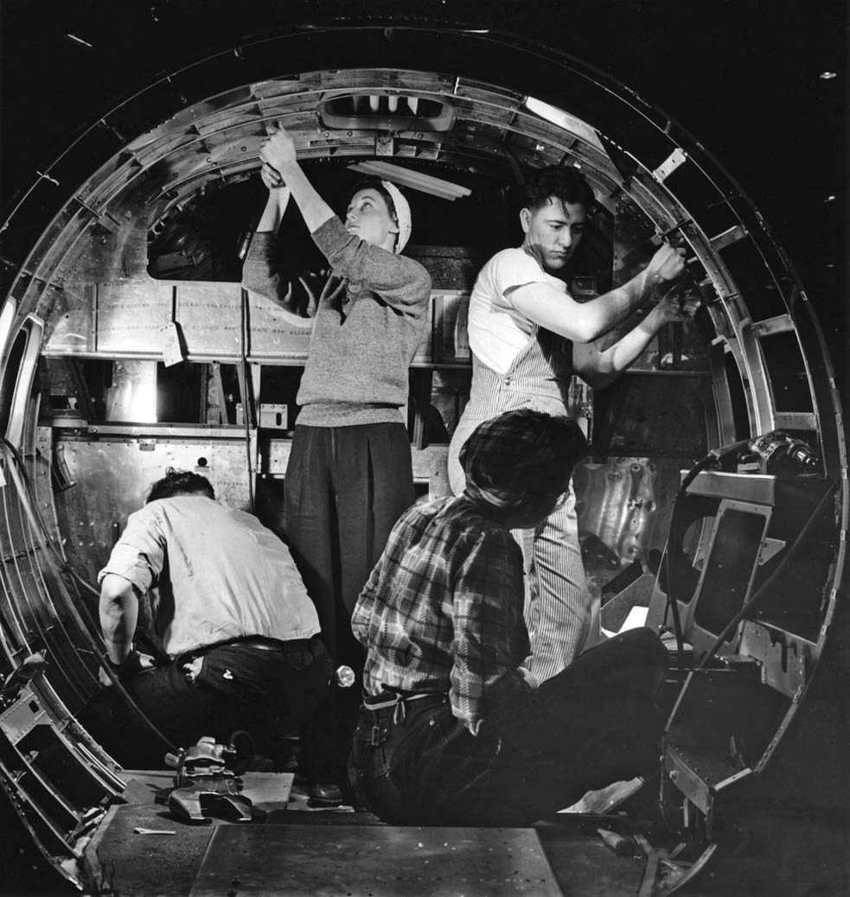

Slide 43
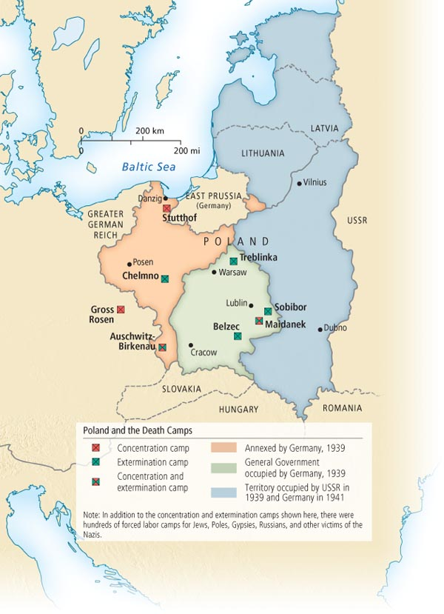
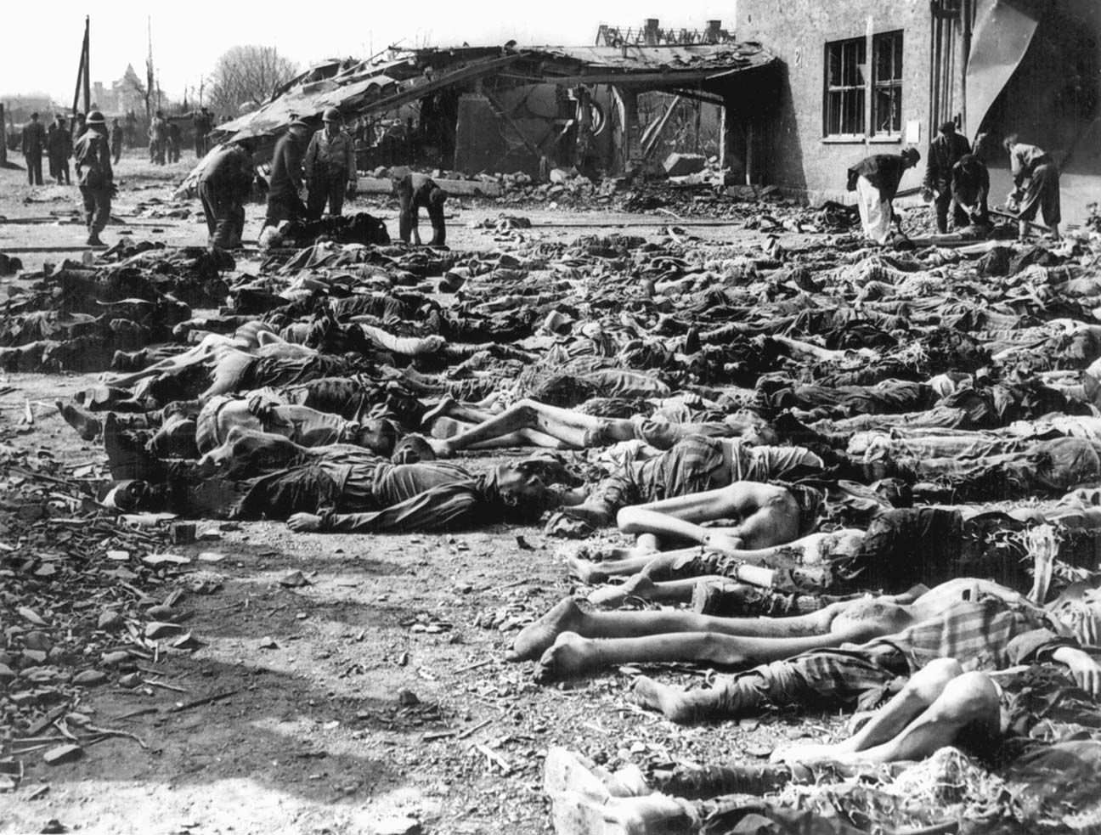
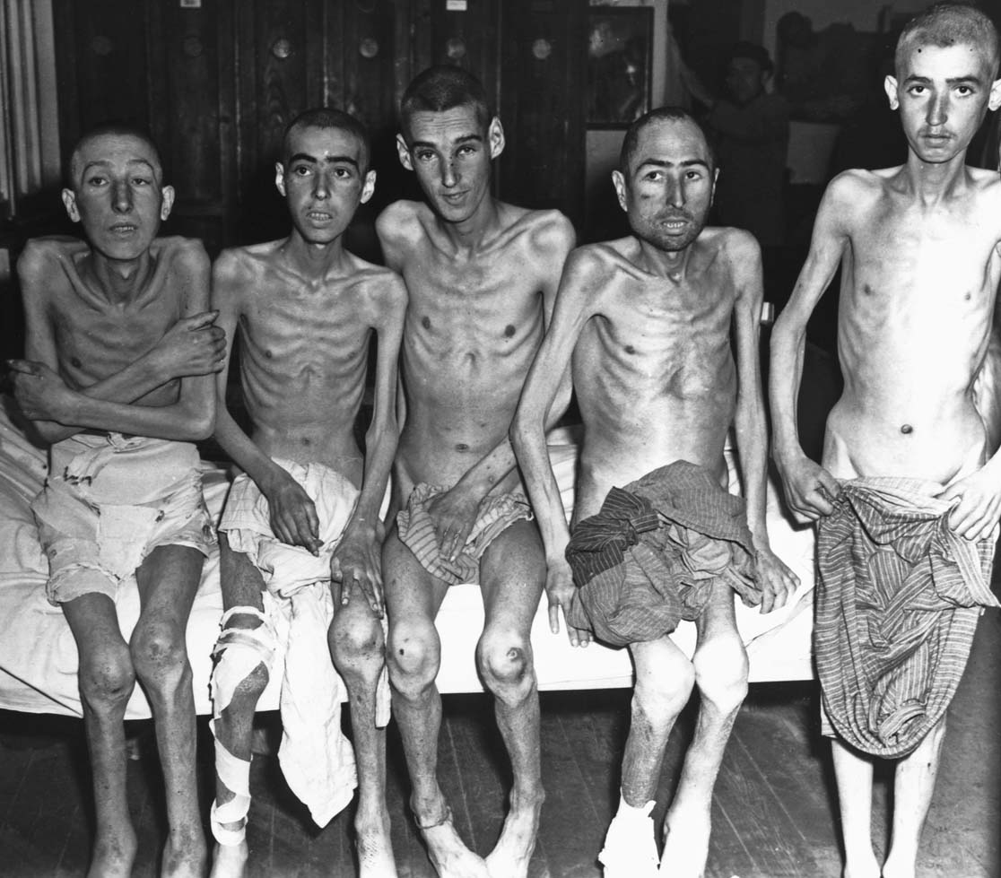
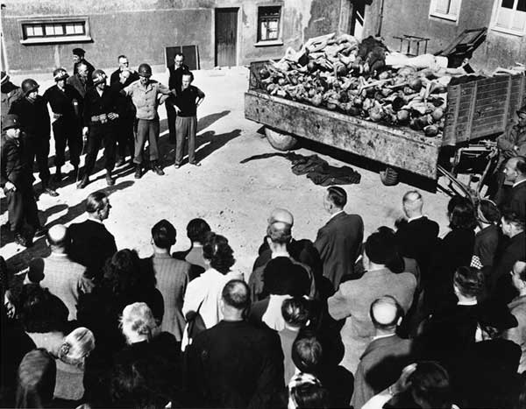
HOLOCAUST
6 mil. Jews
“degenerate” races

Slide 44
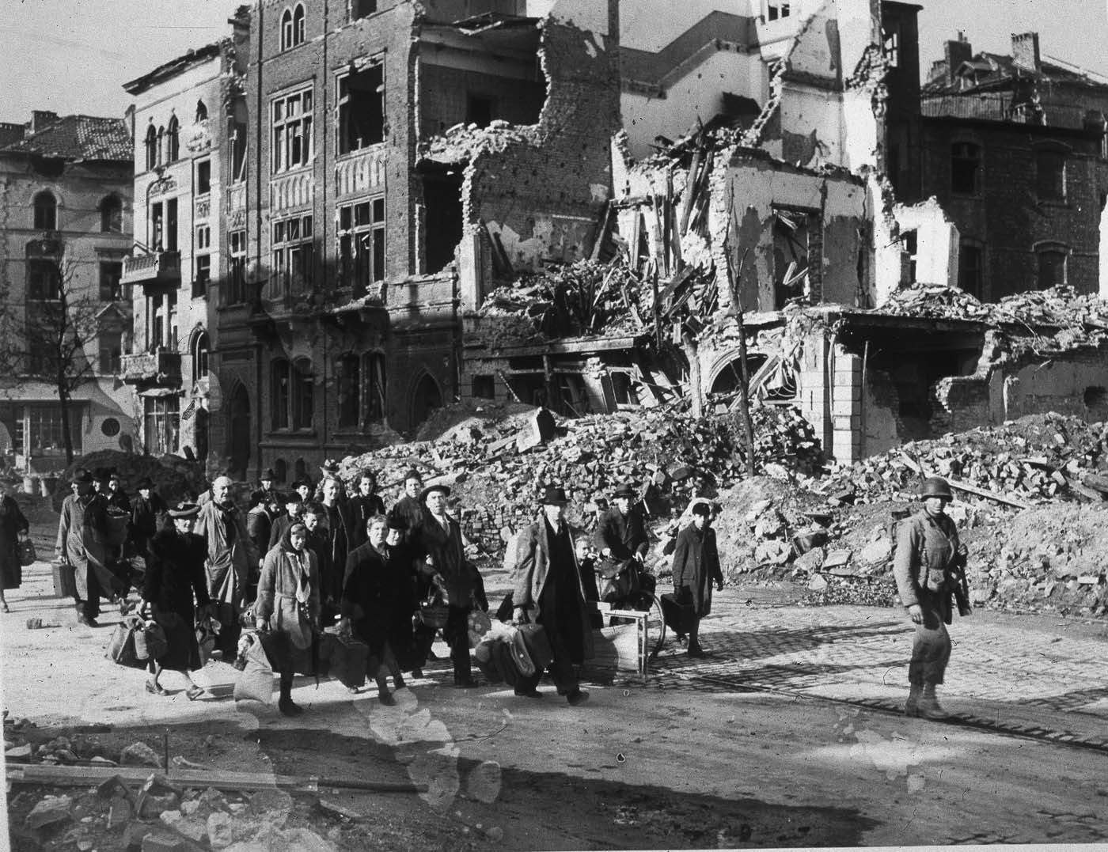
“Total war”
50 mil.
Civilians

