Slide 2
MING
14th cent.

Slide 3
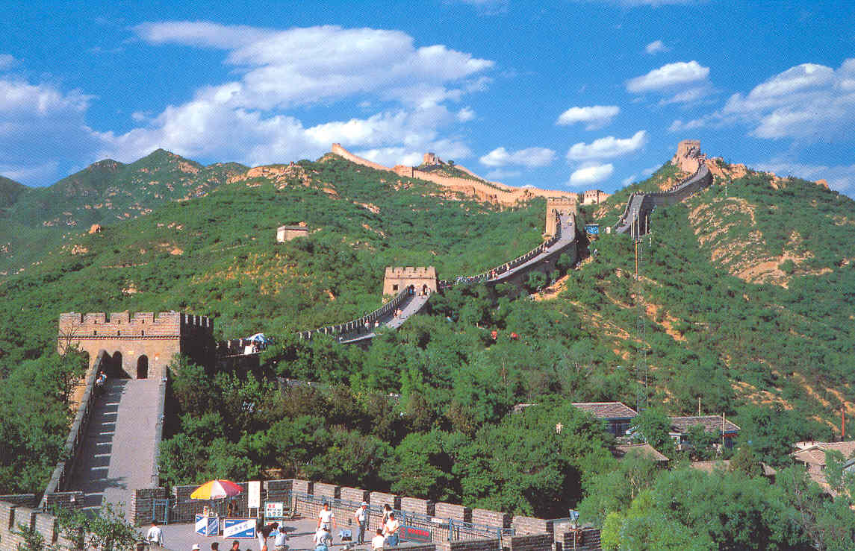
GREAT WALL
4th century b.c.
Ming
1.5k

Slide 4
Scholar-gentry
+++

Slide 5
women
Status?

Slide 6
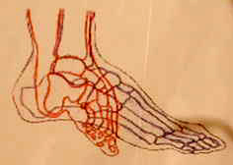
More common

Slide 7
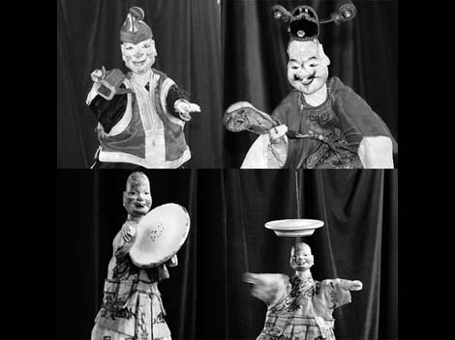
CULTURE
Shows
Underdogs

Slide 8
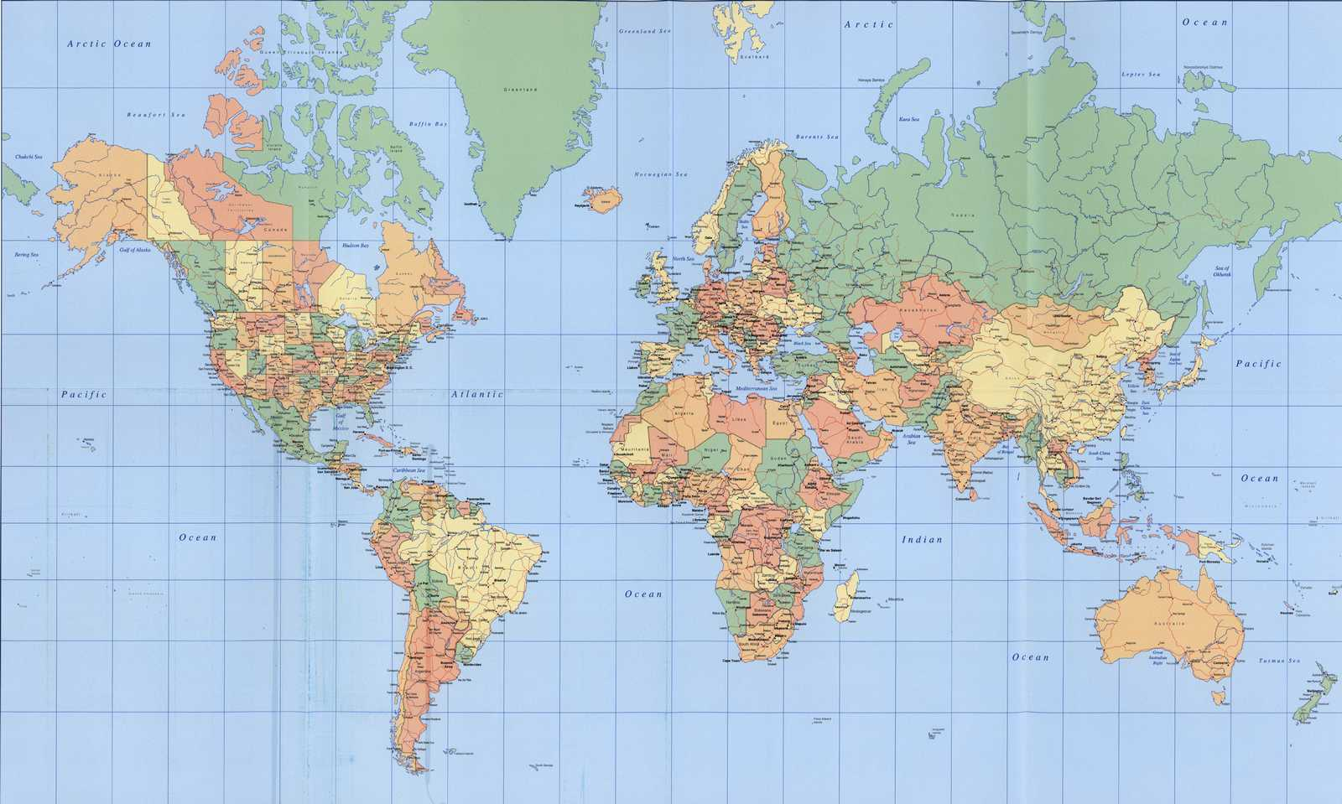
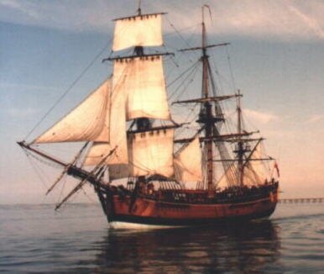
Zhenghe’s voyages
1405-1423

Slide 9
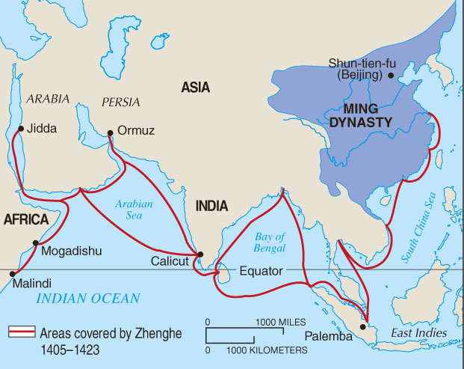

Slide 10
DECLINE
Corruption
Famine
Conservative, complacent

