Slide 2
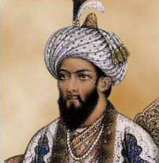
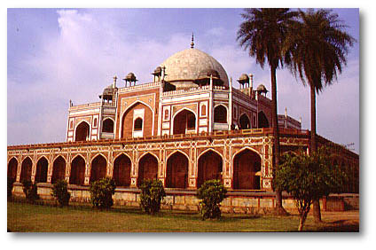
MUGHAL
1520-1800
Nomads, C. Asia

Slide 3
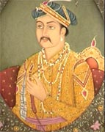
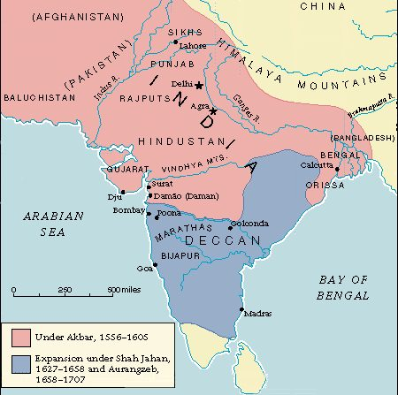
AKBAR
Toleration
Jizya
Pro-Hindu

Slide 4
Women?
Child marriages
Sati

Slide 5
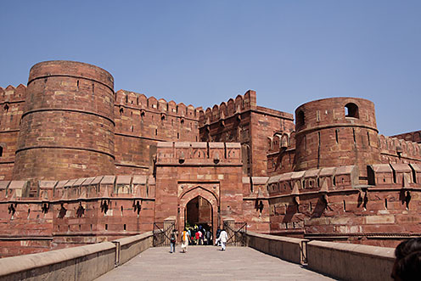
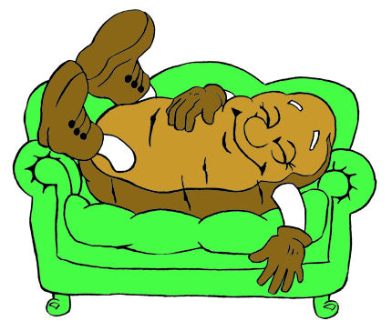
Agra: 200K
Food?

Slide 6
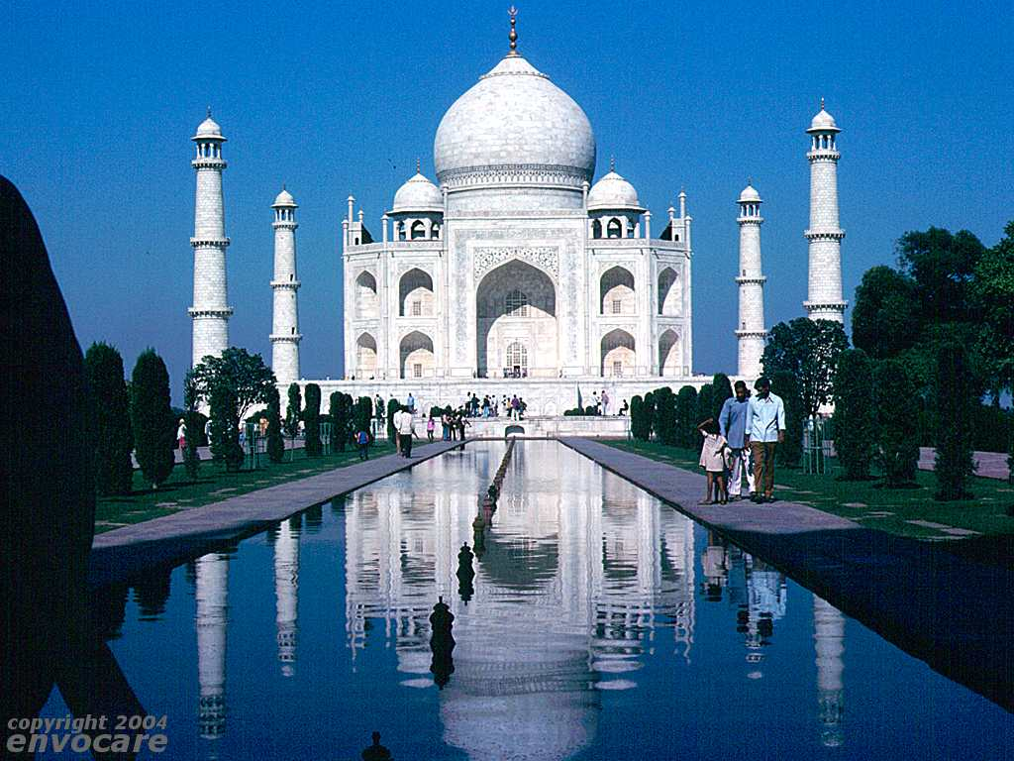
Taj Mahal

Slide 7
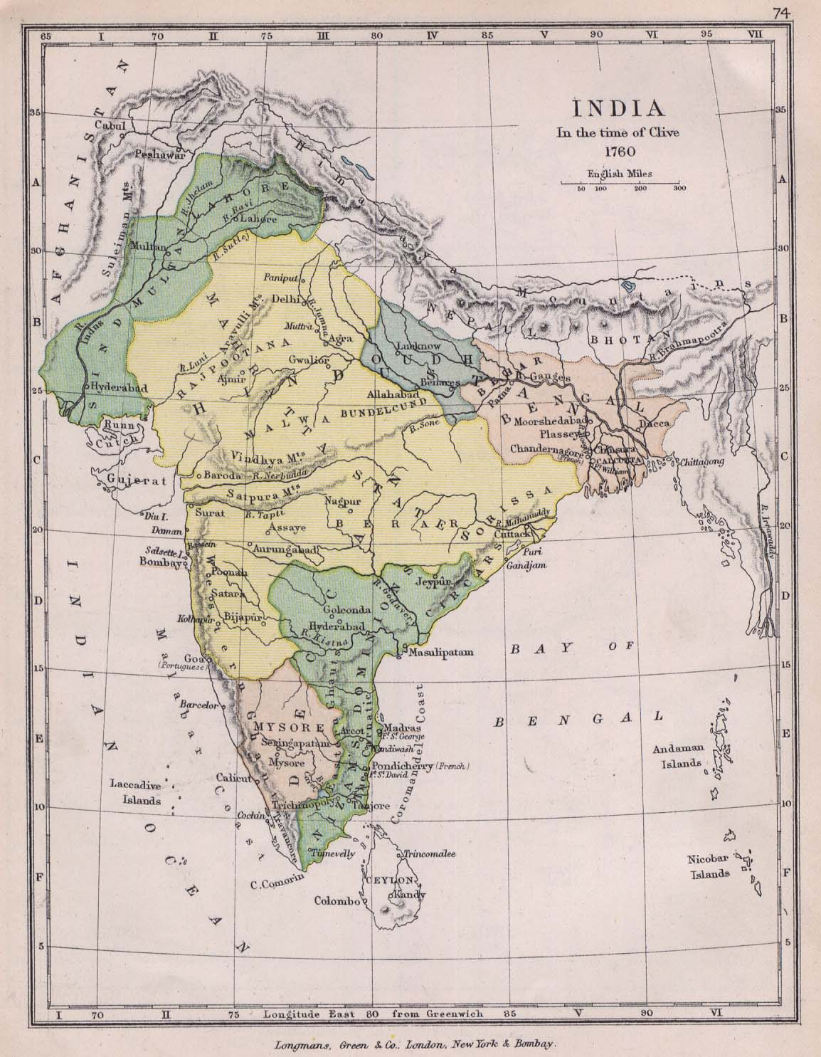
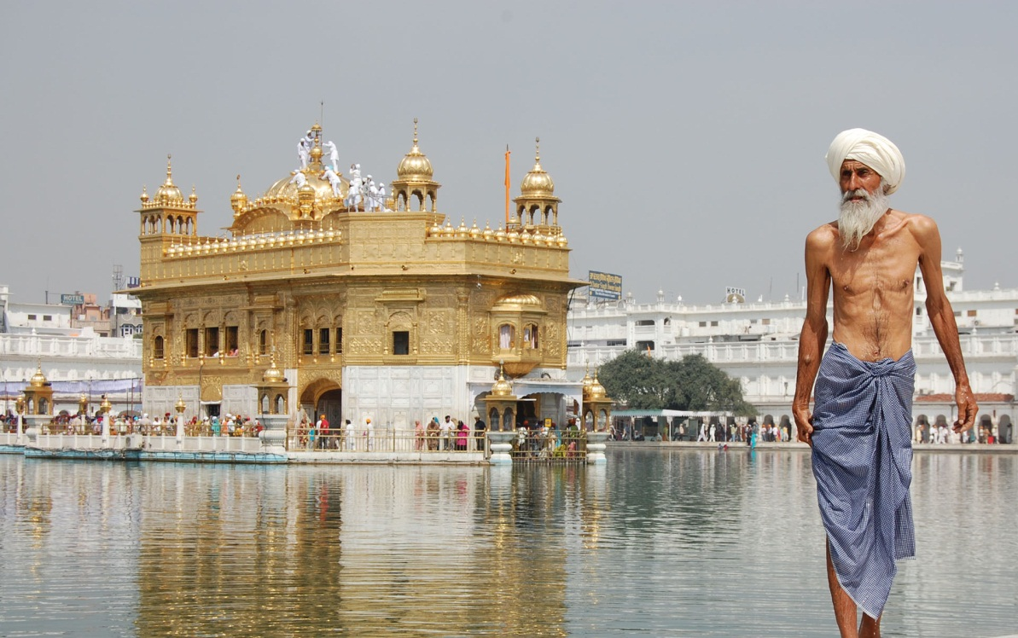
DIVISION
Marathas
W. India
Nationalism
Sikhs
Blend religions
Anti-Islam

