Slide 1
RACE AND RACISM

Slide 2
Historical?

Slide 4
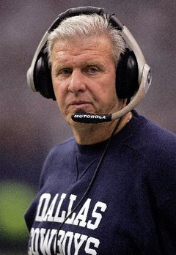
“Jap plays”

Slide 5
HATE CRIMES
Two
“Kenny’s Law”
K. Chiu (O.C.)

Slide 6
???
Anti-immigrant
$$$
“move-in” violence
Police-community relations

Slide 8
IDENTITY?
Who are we?
Nationality?
“Asian”
“American”
First vs. second gen.?

